Slide 1
Turkeys with Dressing
Miss Scarrberry’s 3rd graders helped
dress these turkeys
to keep them safe from being someone’s
holiday dinner!

Slide 2
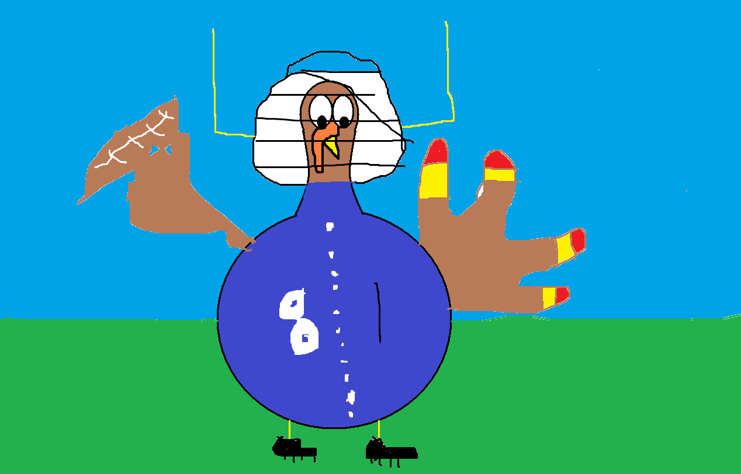
I would like to be a football player because my friend plays football.

Slide 3
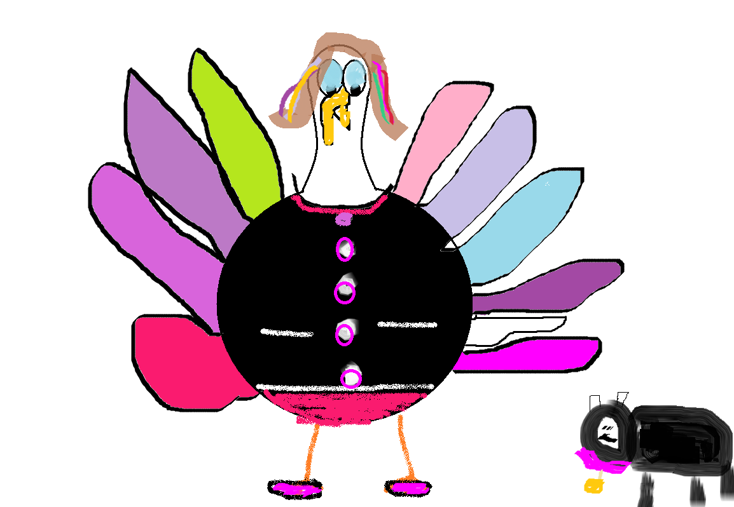
I would like to be a vet because .I like pets my favorite pet is a dog .In fact I have a dog named Minnie Mouse.I also have a friend Kyle he is a vet to.

Slide 4
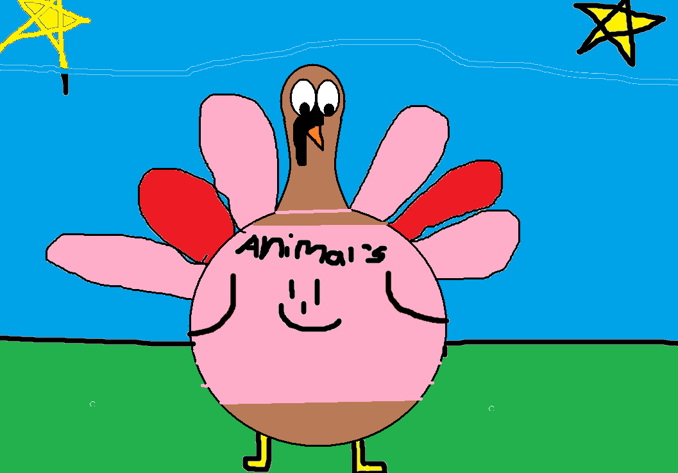
I would like to be a vetranairian when I grow up I would help all of those harmend animals I would love to help you and your animal.

Slide 5
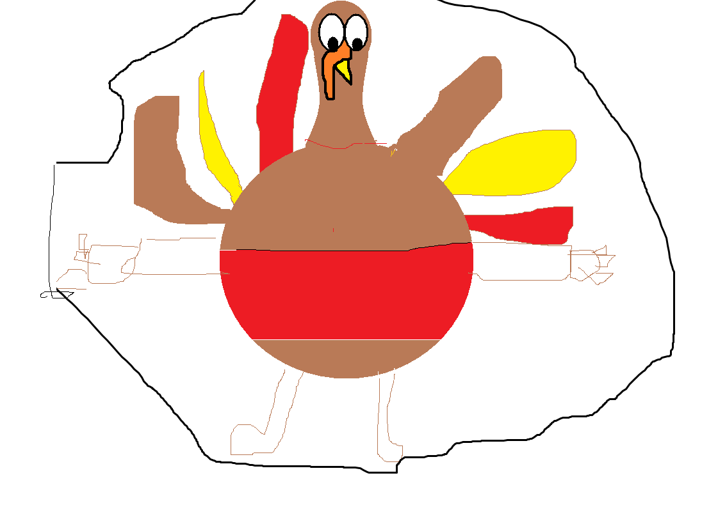
It would be fun to be a teacher it helps kids spell and read.

Slide 6
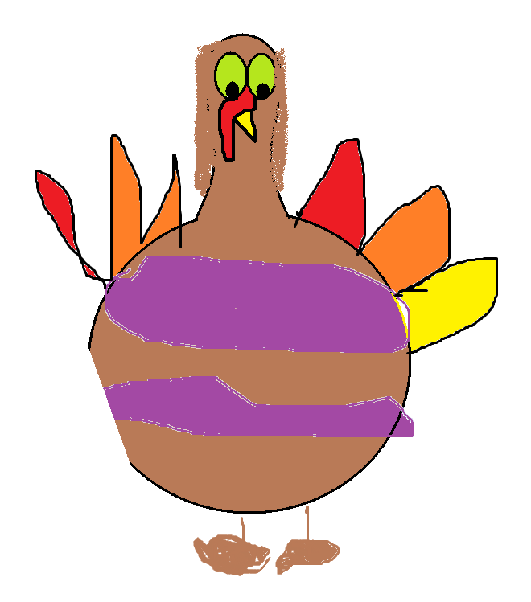
I think it would be cool to be a swim teacher. because I love the water and children .i love the water and I love to swim in the water.i would hope the children would have fun.i kown I would have fun.

Slide 7
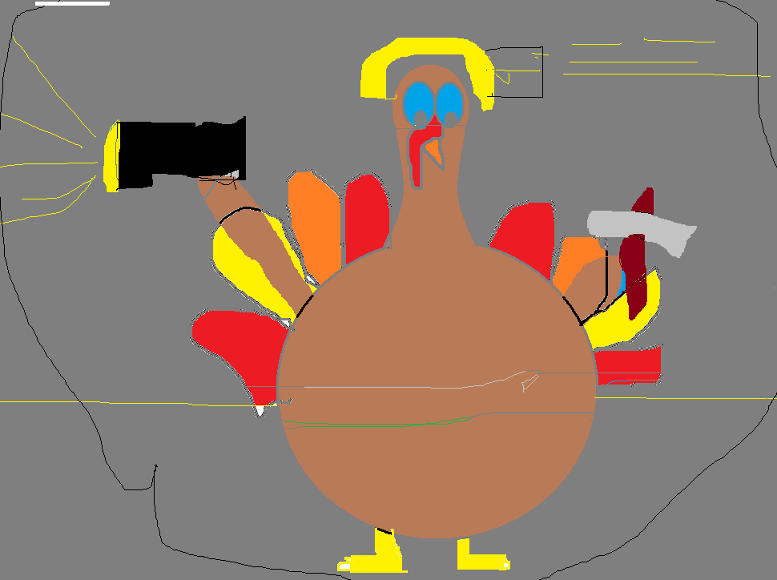
I am going to miner I will get ores and rock. Miner is what I want to be.
0.

Slide 8
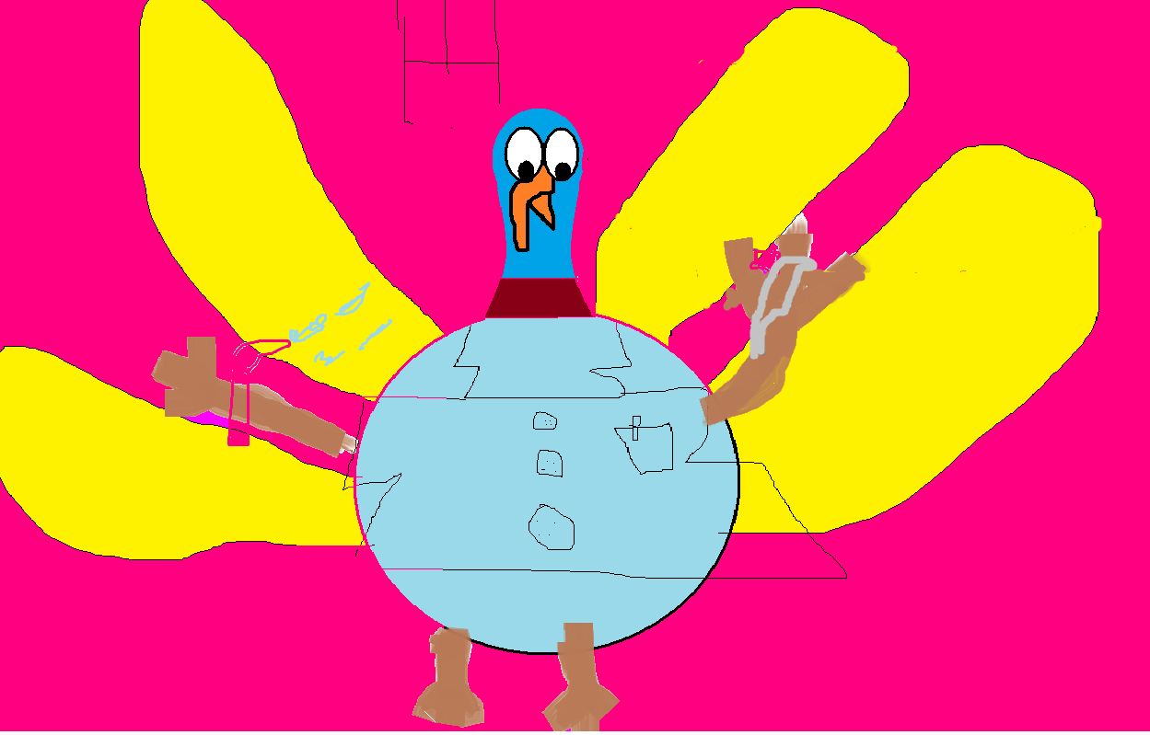
I think it would be neat to be a dentist because I like touching peoples teeth

Slide 9
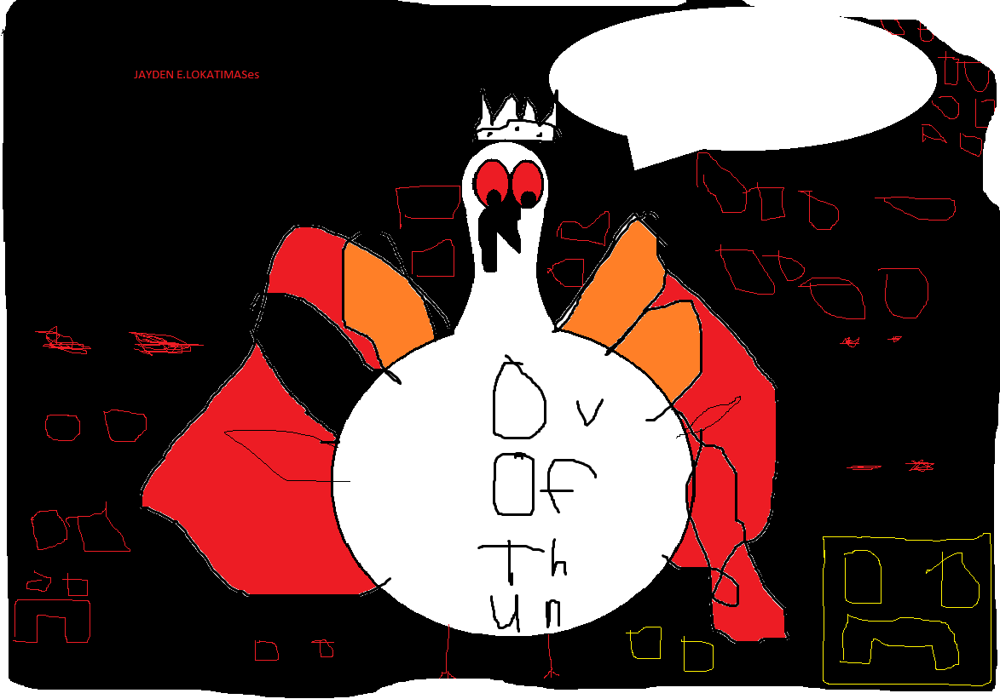
I would like to be supreme overlord of the undead when I grow up. I use a bullwhip to force people. And I will also use my fangs to control them. And that’s why I want to be supreme overlord of the undead!!!!!

Slide 10
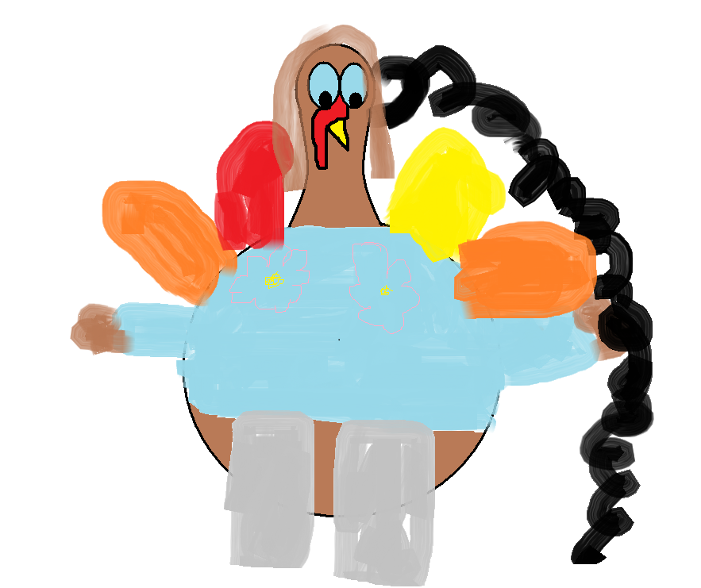
I think it would be cool to be a nurse. I think it would be cool because a lot of my family members are nurses.

Slide 11
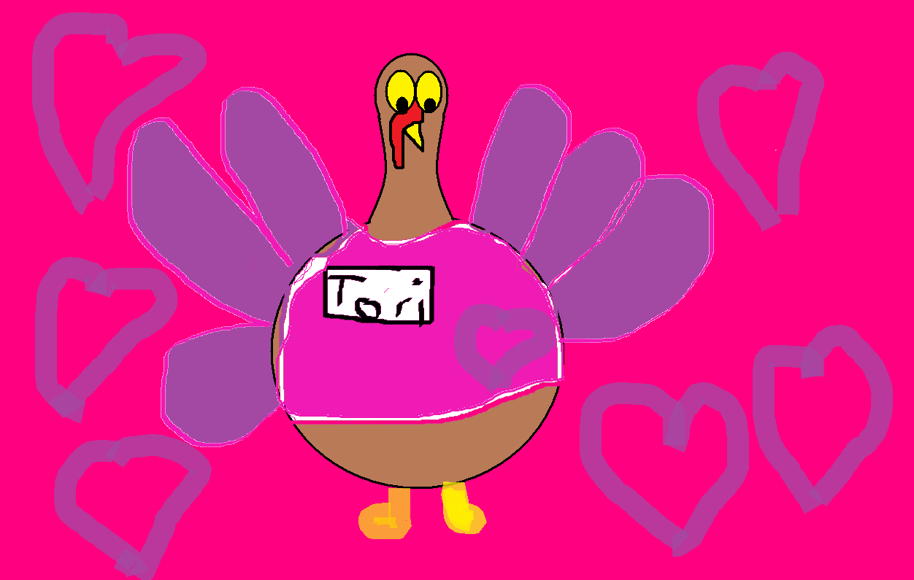
I AM A Nurse. I CAN HELP PEOPLE.I AM VARY NICE.I will give you a suker or a popcikle. I love my job.

Slide 12
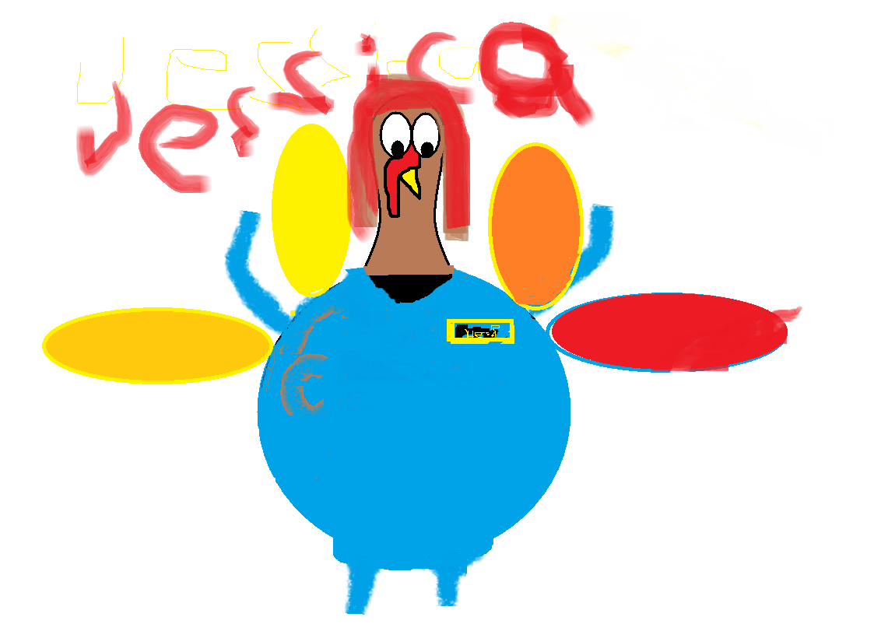
I want to be a nurse because you get to save peoples lives and help sick people

Slide 13
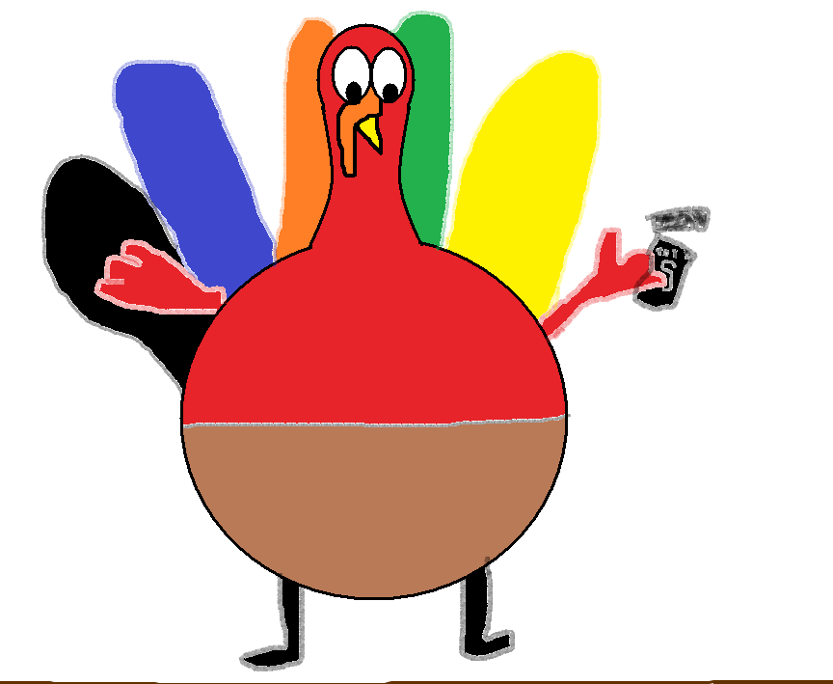
I want to be a actor when I grow up because you get to be on TV and it will be fun.

Slide 14
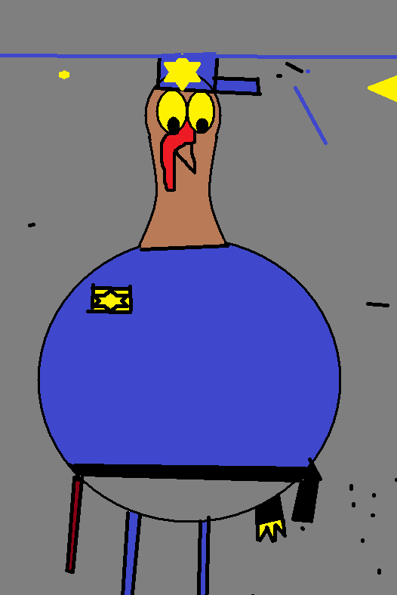
I wont to be a poles because I like to keep people safe from bad GIES.

Slide 15
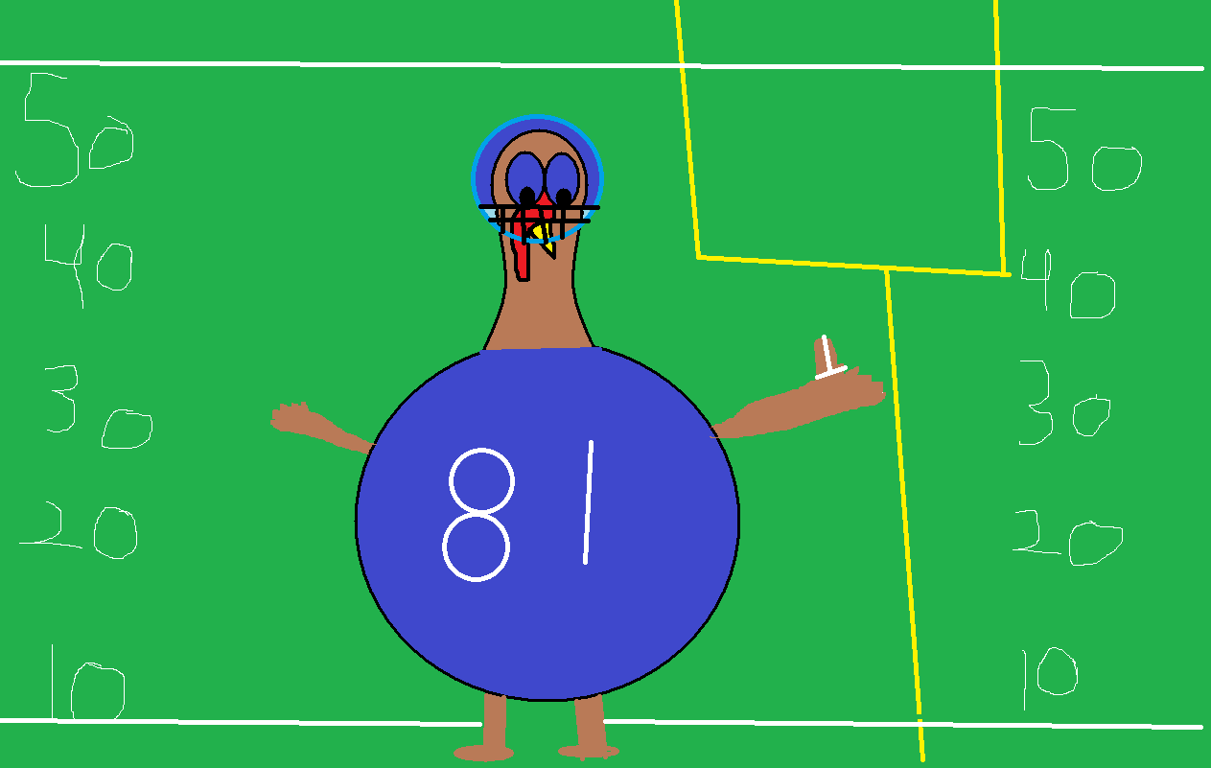
I want to be a football player because am fast at runing

Slide 16
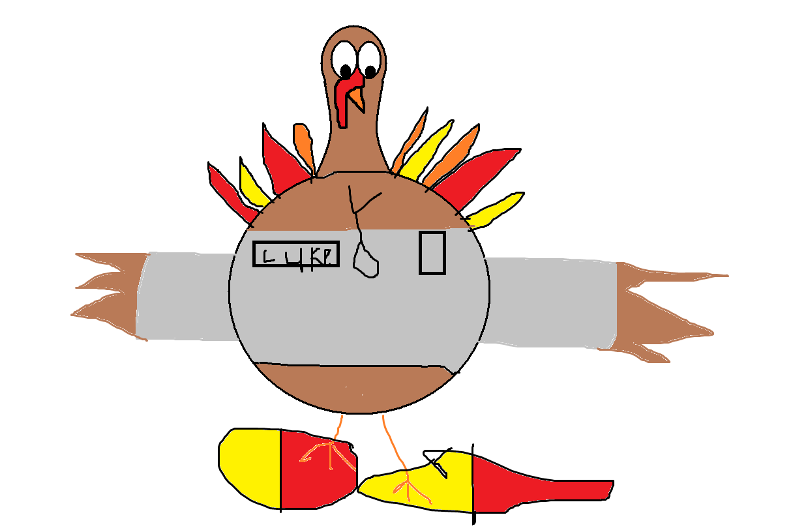
I think it would be great to be a veterinarian. So I can help animals. I checking animals hart beat with my stethoscope.

Slide 17
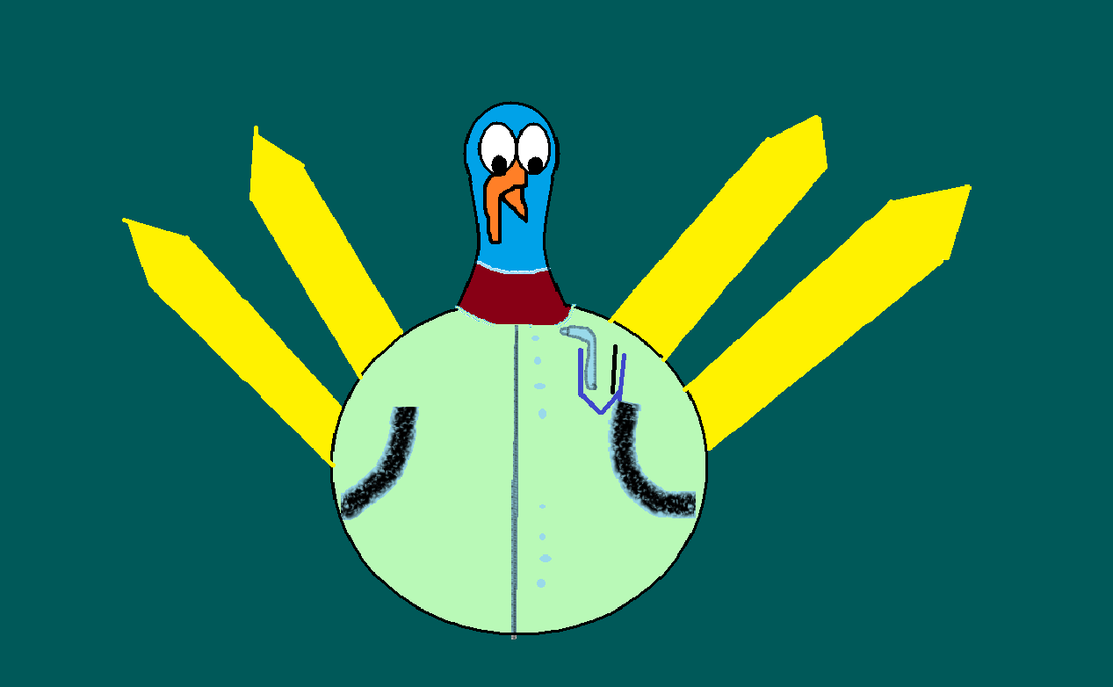
I thank it would be really cool to be a Dentist when I grow up. Because I really like to touch people’s teeth .Also
My favorite word is Dentist
.THANK YOU!!!!!!!!!!!

Slide 18
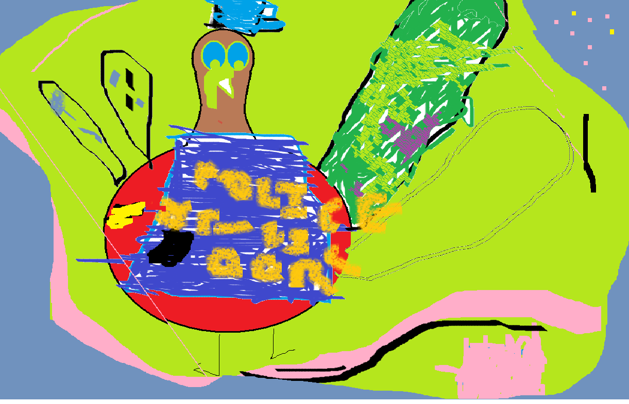
Ima police man im going to arest you

Slide 19
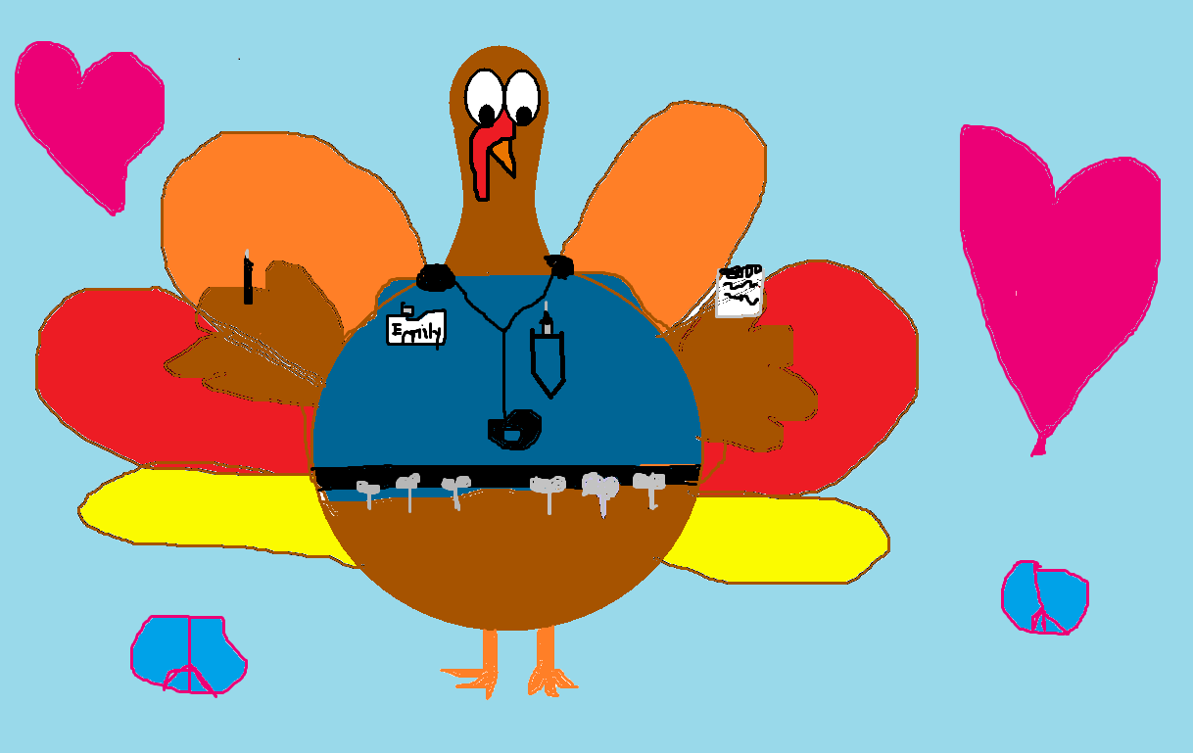
I think it would be great to be a nurse my dad is one . I have a pen and note pad and I have 6 scissors and a name tag that says Emily.

Slide 20
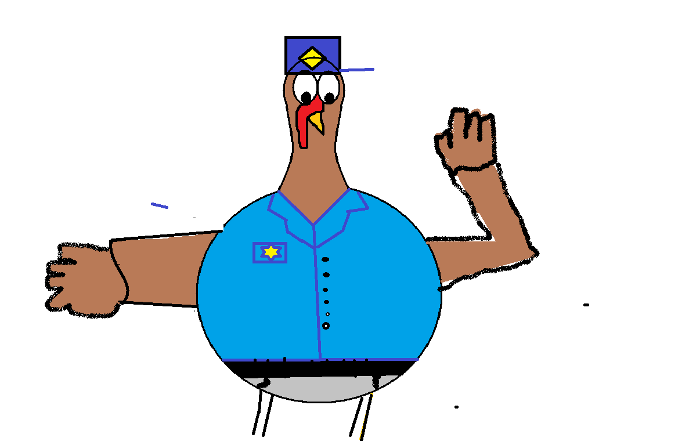
I want to be’ a police because I want to chase bad guys and lock thim up in jall

Slide 21
I would like to be a vet because .I like pets my favorite pet is a dog .In fact I have a dog named Minnie Mouse.I also have a friend Kyle he is a vet to.

Slide 22
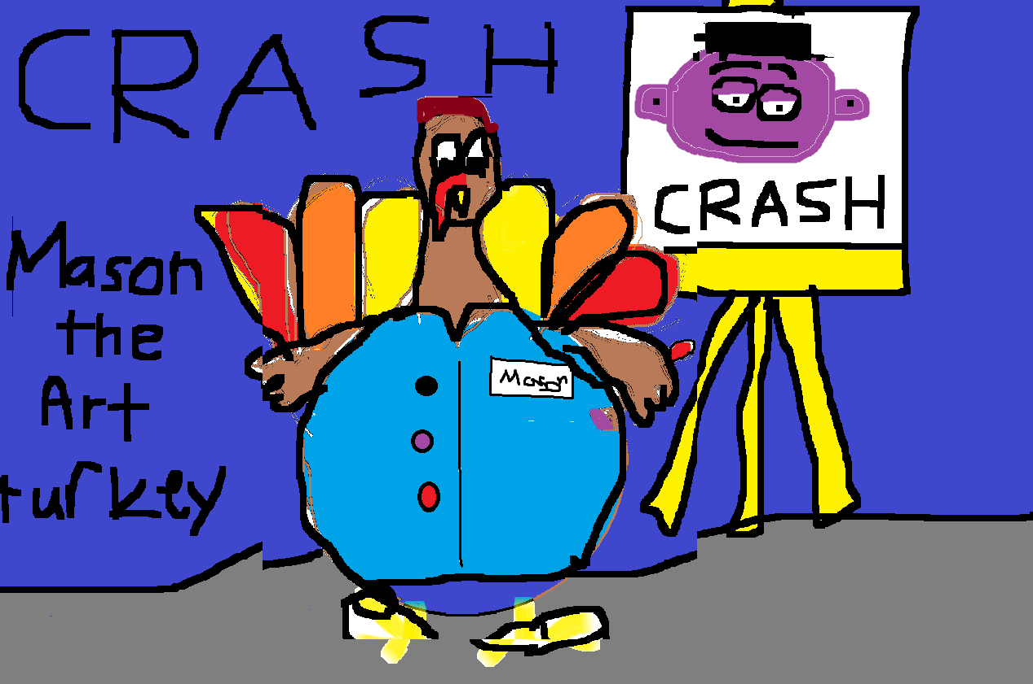

Slide 23
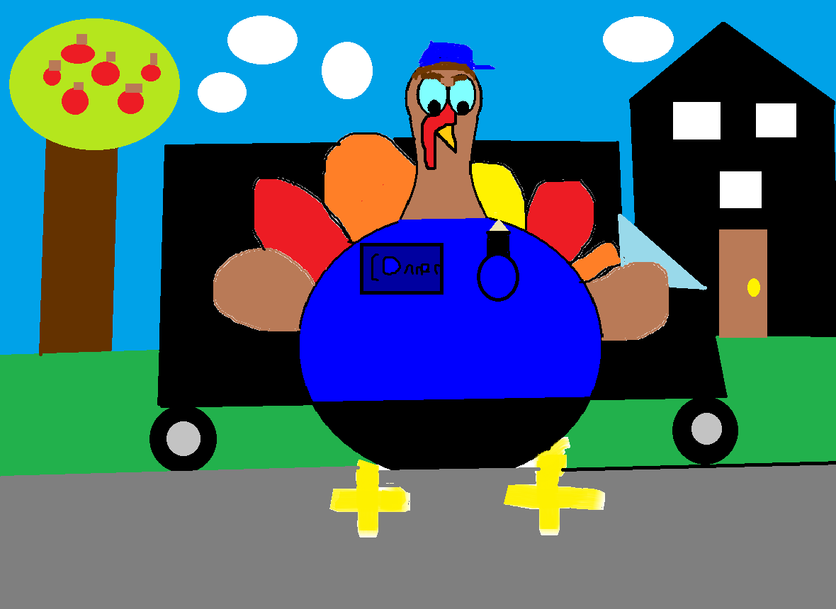
It would
be cool to be a
Mail man.

Slide 24
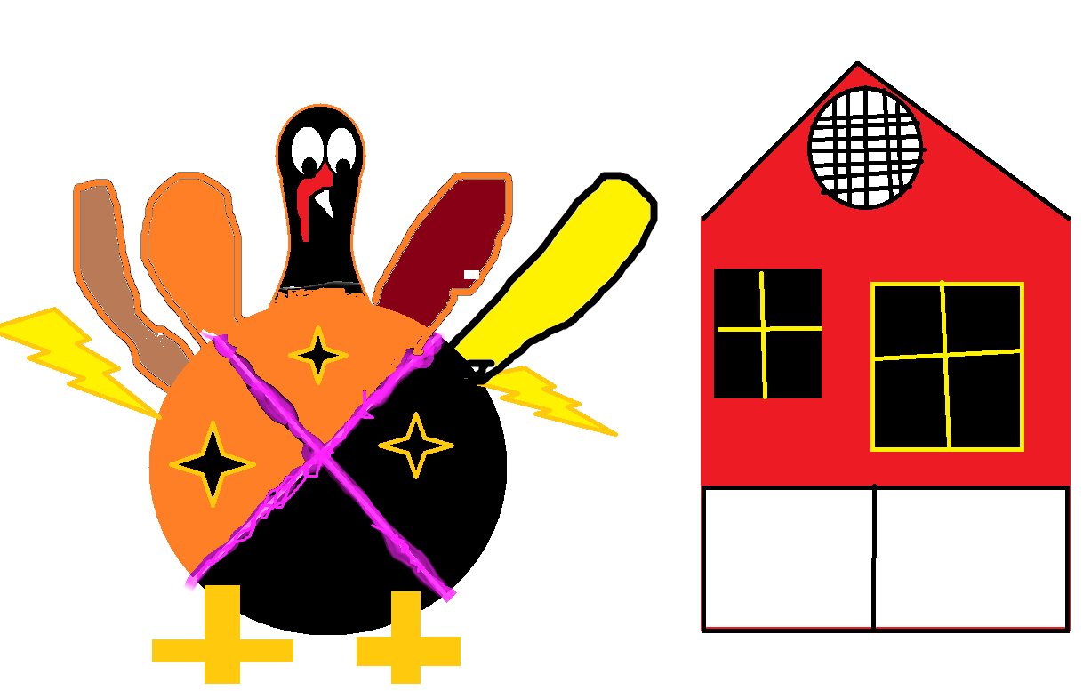
It would be cool to be a ninja
And a producer.

Slide 25
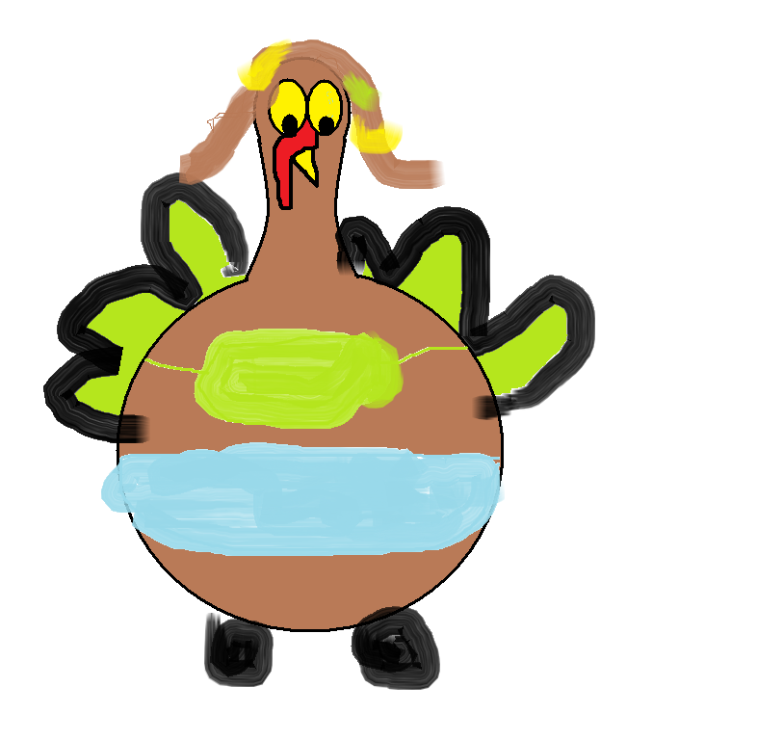
i think it would be cool to be a lifgurd because they save people and I love to swim I love bathing suits because they remind me of leotards
That’s why I want to be a swimmer
☺☺;) ☺☺ ☺
th

Slide 26
It would be fun to be a teacher it helps kids spell and read.

Slide 27
I think it would be neat to be a dentist because I like touching peoples teeth

Slide 28
I would like to be supreme overlord of the undead when I grow up. I use a bullwhip to force people. And I will also use my fangs to control them. And that’s why I want to be supreme overlord of the undead!!!!!

Slide 29
I think it would be cool to be a nurse. I think it would be cool because a lot of my family members are nurses.

Slide 30
I AM A Nurse. I CAN HELP PEOPLE.I AM VARY NICE.I will give you a suker or a popcikle. I love my job.

Slide 31
I want to be a teacher because it is fun to help kids read and play. I hope I can be a teacher.

Slide 32
I want to be a nurse because you get to save peoples lives and help sick people

Slide 33
I want to be a actor when I grow up because you get to be on TV and it will be fun.

Slide 34
I wont to be a poles because I like to keep people safe from bad GIES.

Slide 35
I want to be a football player because am fast at runing

Slide 36
I think it would be great to be a veterinarian. So I can help animals. I checking animals hart beat with my stethoscope.

Slide 37
I thank it would be really cool to be a Dentist when I grow up. Because I really like to touch people’s teeth .Also
My favorite word is Dentist
.THANK YOU!!!!!!!!!!!

Slide 38
Ima police man im going to arest you

Slide 39
I think it would be great to be a nurse my dad is one . I have a pen and note pad and I have 6 scissors and a name tag that says Emily.

Slide 40
I want to be’ a police because I want to chase bad guys and lock thim up in jall

