Slide 1
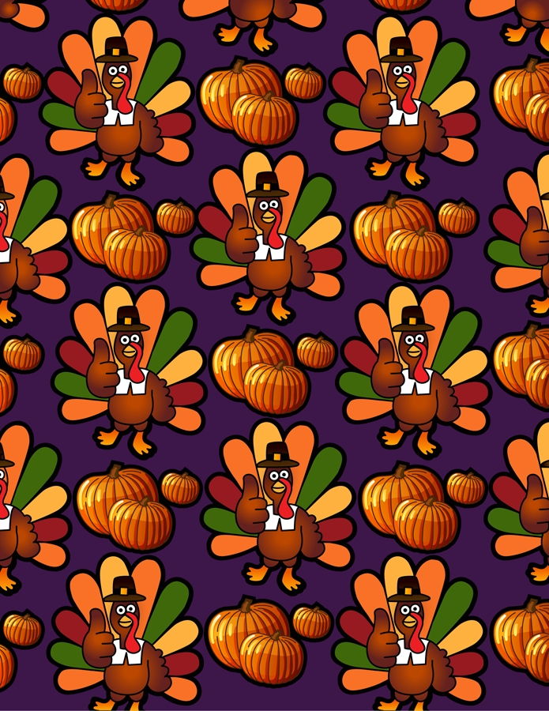
Turkeys with Dressing
Mrs. Neu’s 3rd graders helped
dress these turkeys
to keep them safe from being someone’s
holiday dinner!

Slide 2
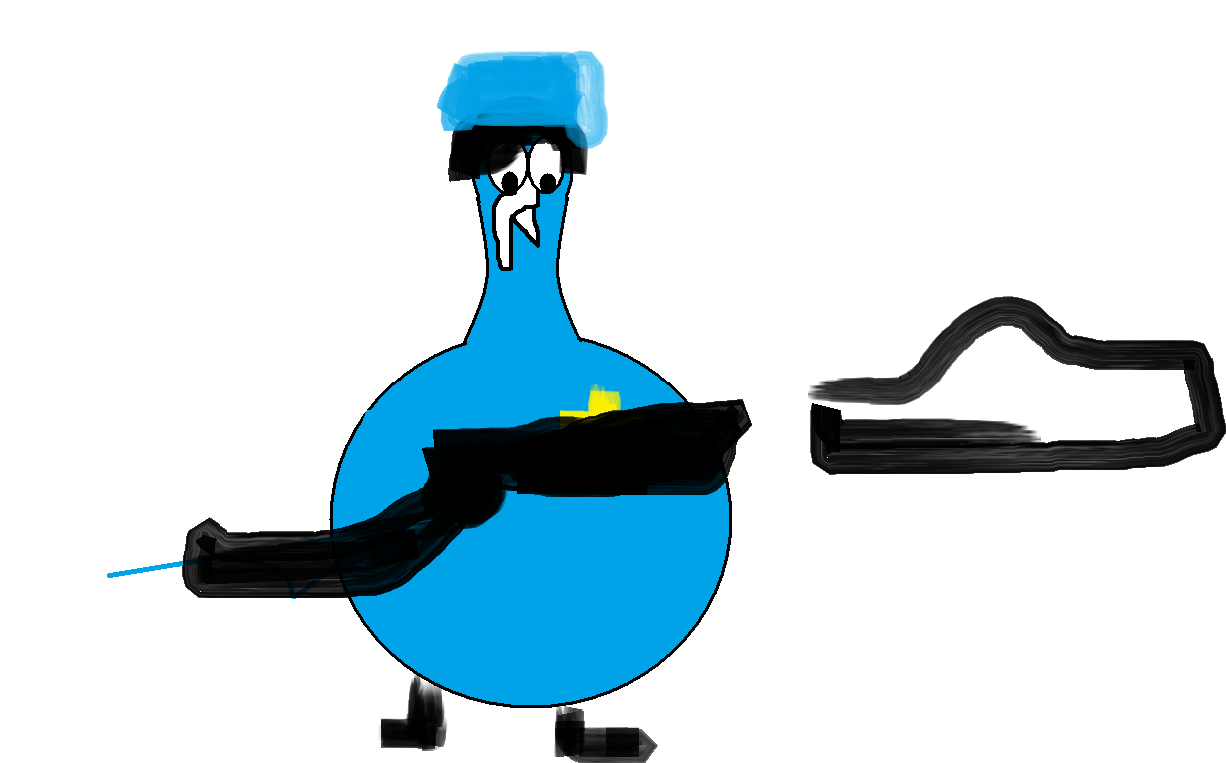
if i were a cop I will arrest bad guys and die with pride .

Slide 3
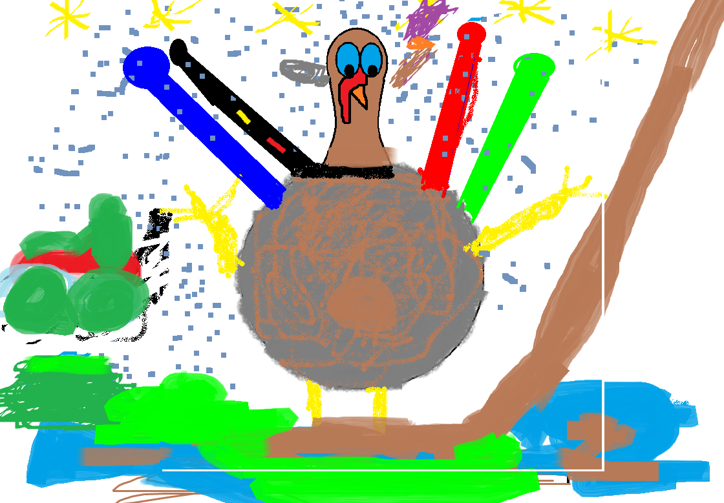
I think I would love to be a hill climber when I grow up.

Slide 5
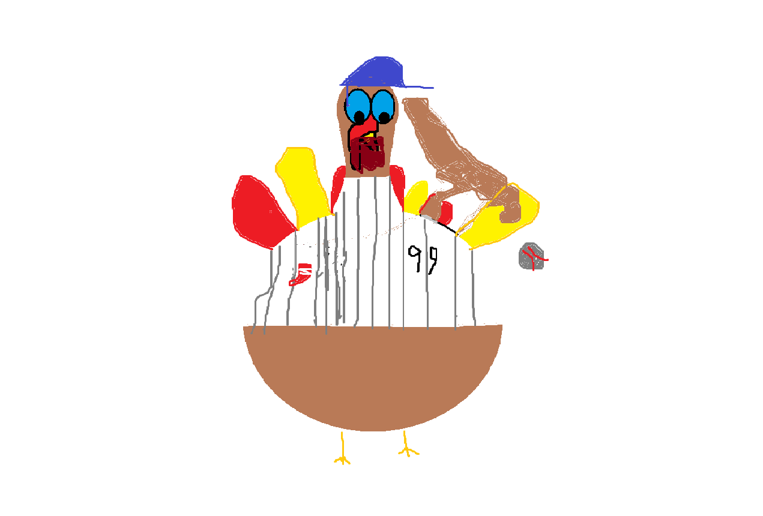
I want to be baseball player I want to play for the Boston red socks power of the beard and I like the old stadium its very old that how come I like it I would like to be number 99 or 56 I like the beards well some don’t have long beards or mustachis.

Slide 6
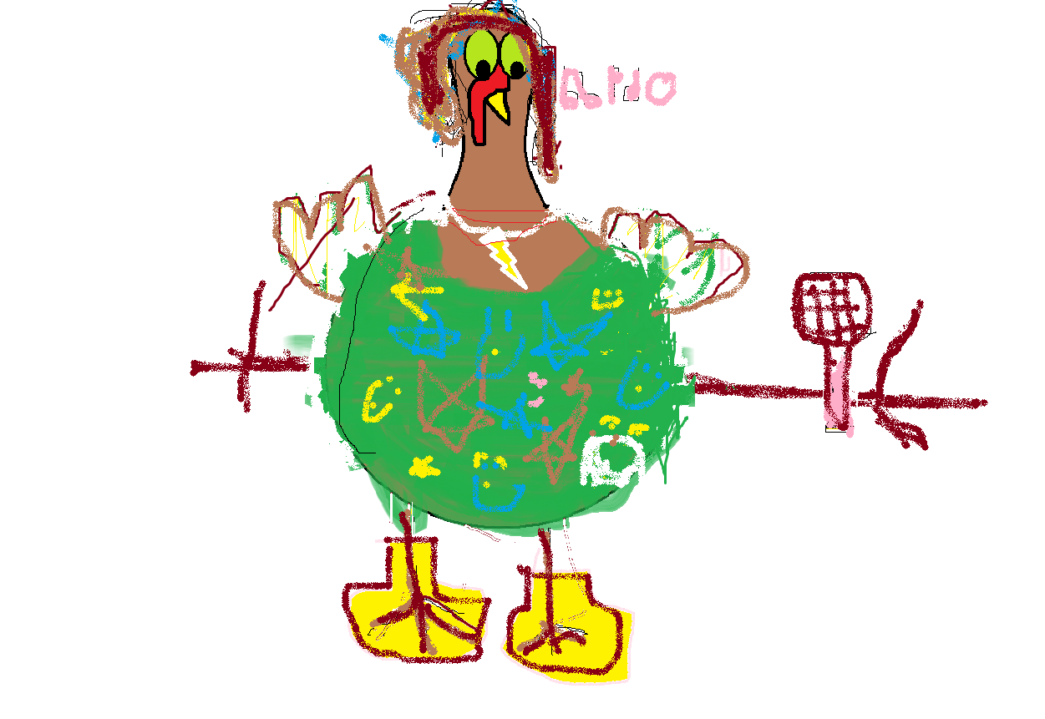
It would be great to b e a singer because you could tour.

Slide 7
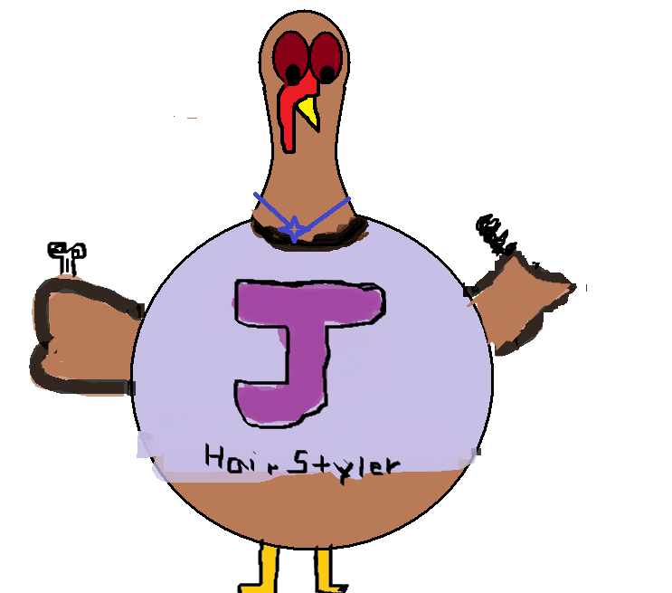
I would Like to be a hair stylist.i will brush hair and comb hair highlight hair.i will be in bisness with my friend lizzy we will call it l.j

Slide 8
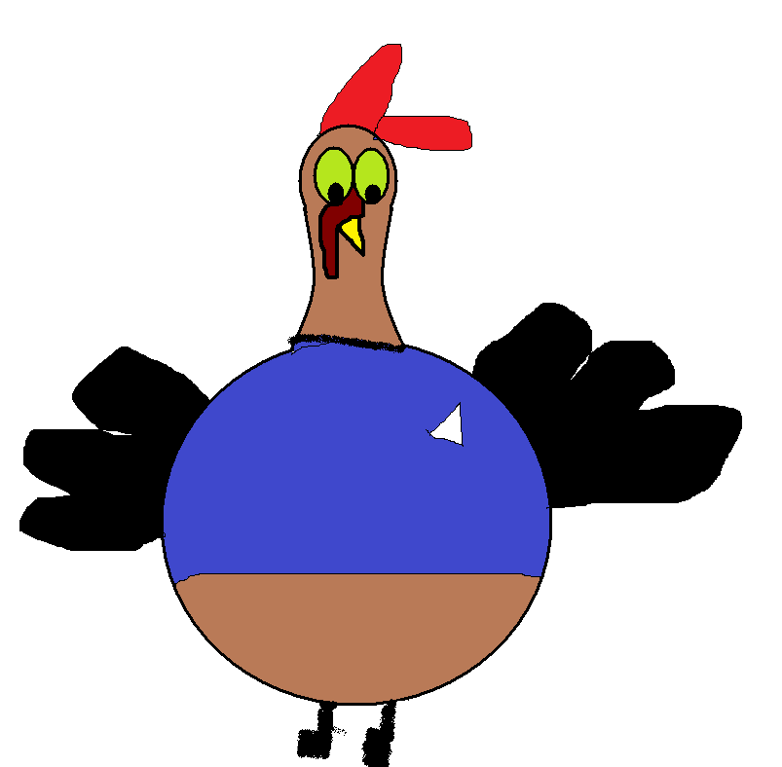
HI IM TURKEY Garrett I AM 8 YEARS OLD I want to be a factory guy when I get older hehe

Slide 9
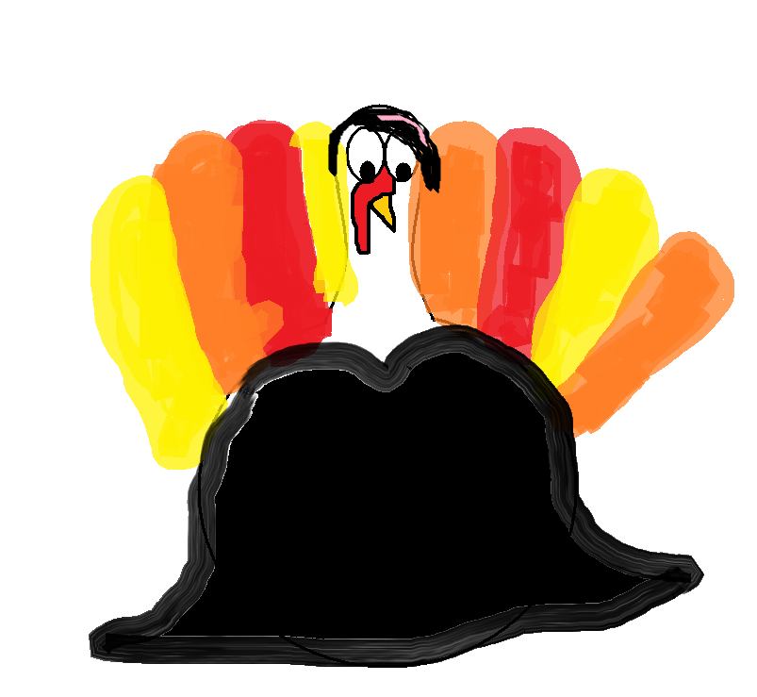
I would like to be a rock star because you get to ROCK OUT!

Slide 10
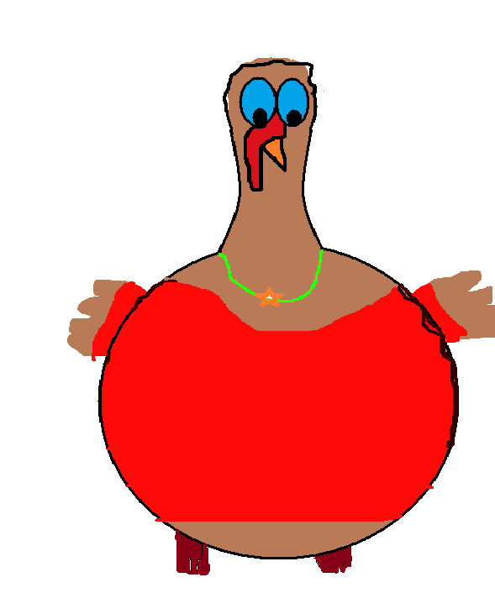
I think it would be cool to be a super star to own 100000000000000000000000000 dollars and go shopping a lot and I will cat name stipes

Slide 11
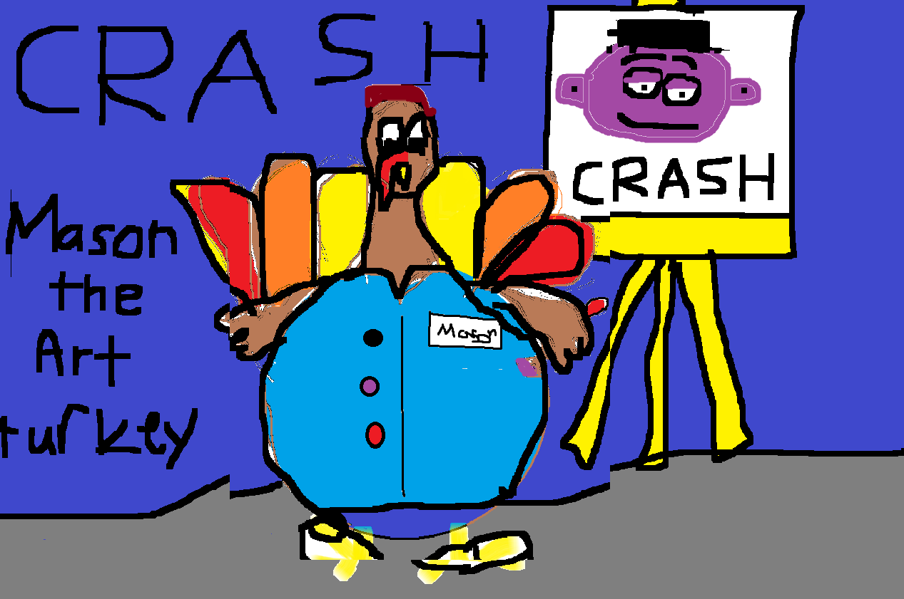

Slide 12
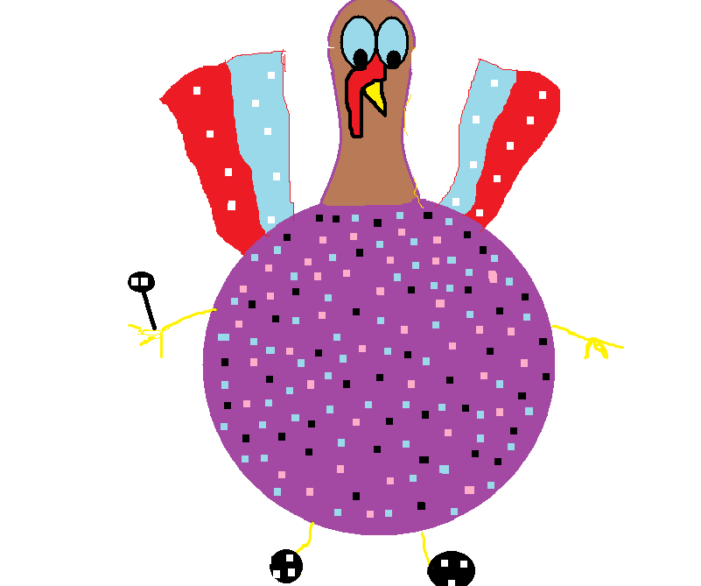
I think it would be fasinating to be a singer.

Slide 13
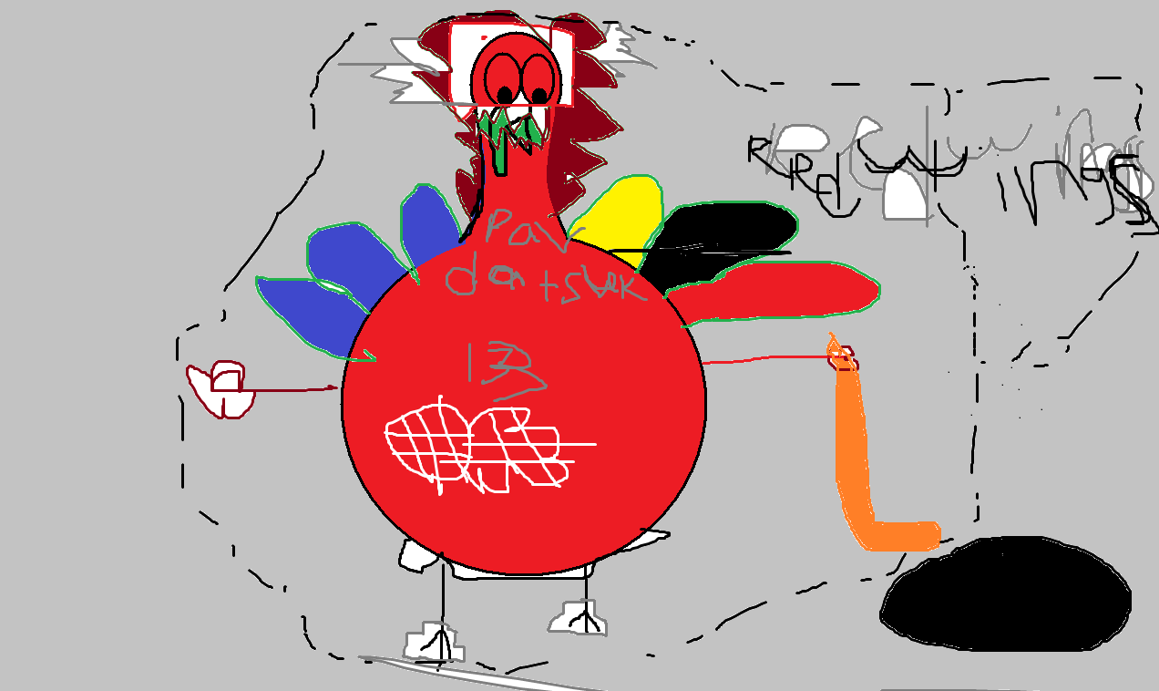
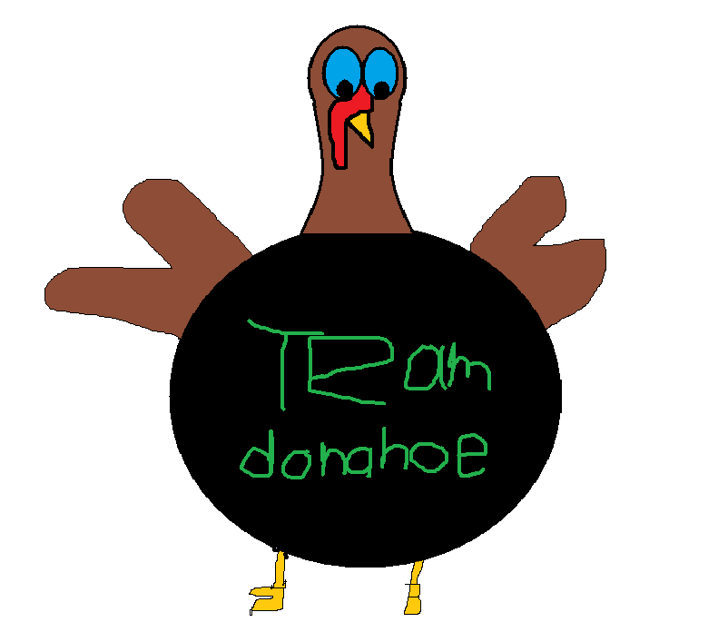
I want to be a hockey player because I can knock out peoples teeth. I can make a lot of goals and I get to have fun and I want to play for the redwings and I want to be number 13 and I want to change my name to that name and when I play I am going to be 35.
I think it would be fun to be a wrestler. I would go to national and win tournament’s. I would also go to state’s and regional’s and win them all. I would go to really awesome team’s. When I grow up I will be an awesome coach and get lots of money.

Slide 14
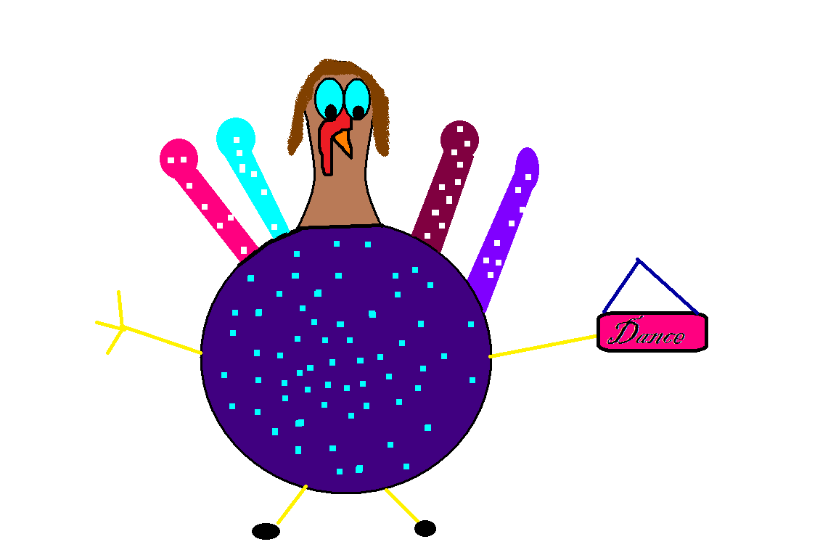
I think it would be cool to be a dancer. I hope a singer will pick me to dance well they sing.

Slide 15
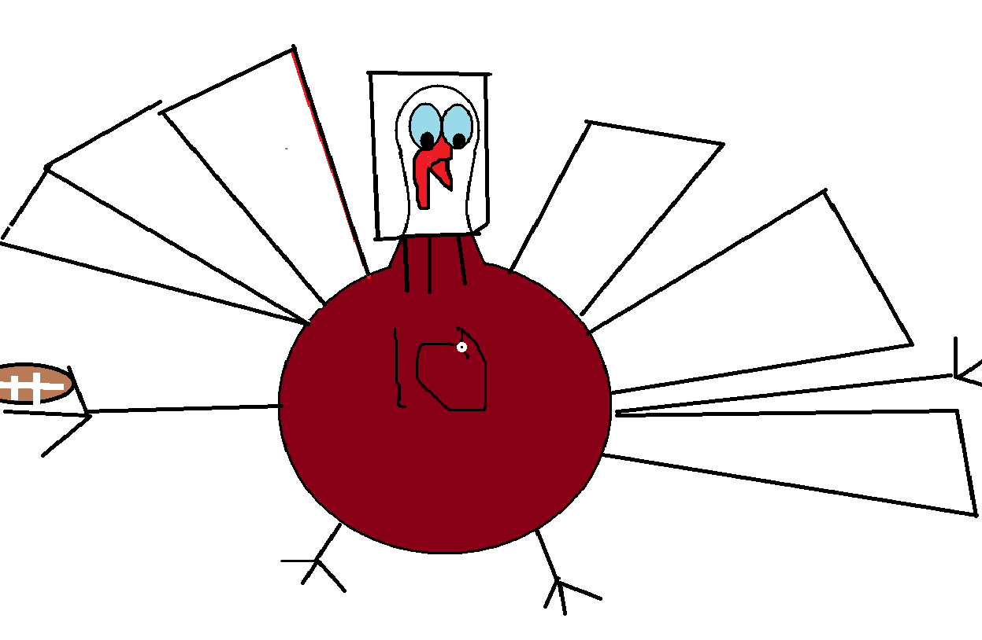
I would love to be in the NFL that’s my dream is to be in the NFL I HOPE I go into the NFL is it your dream to go in the NFL.

Slide 16
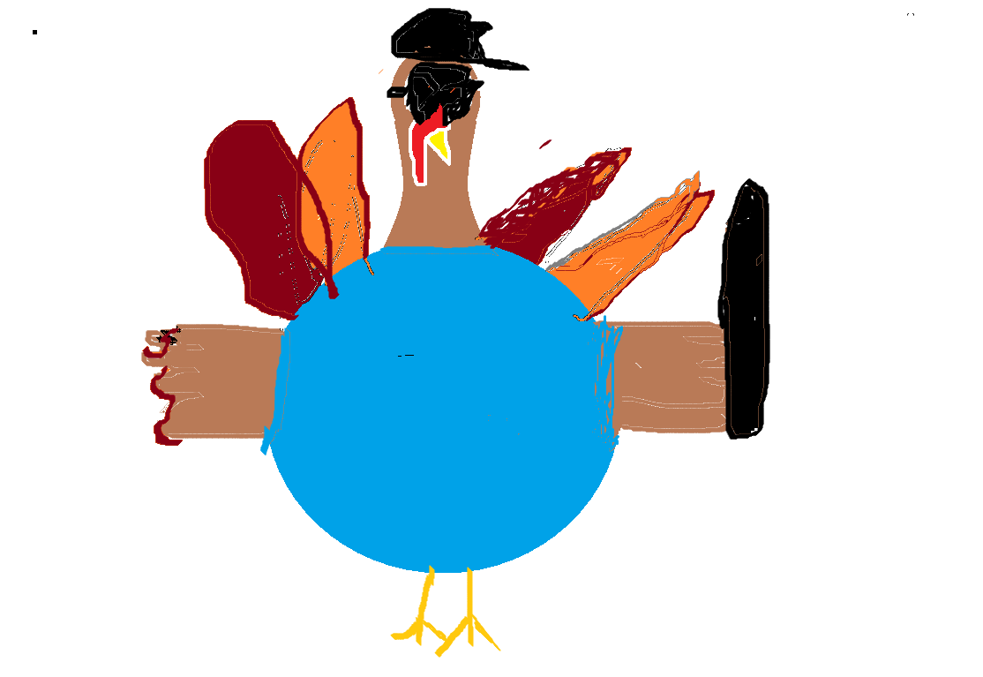
I will be a cop I will be a herotoo so I can save the day.

Slide 17
Can you guess who I am?
I am the one that cleans cars. I’m a star at it. I have a cloth in my hand. When I first tried it, I felt amazed because I felt good.so any time you need your car cleaned, you just ask me.

Slide 18
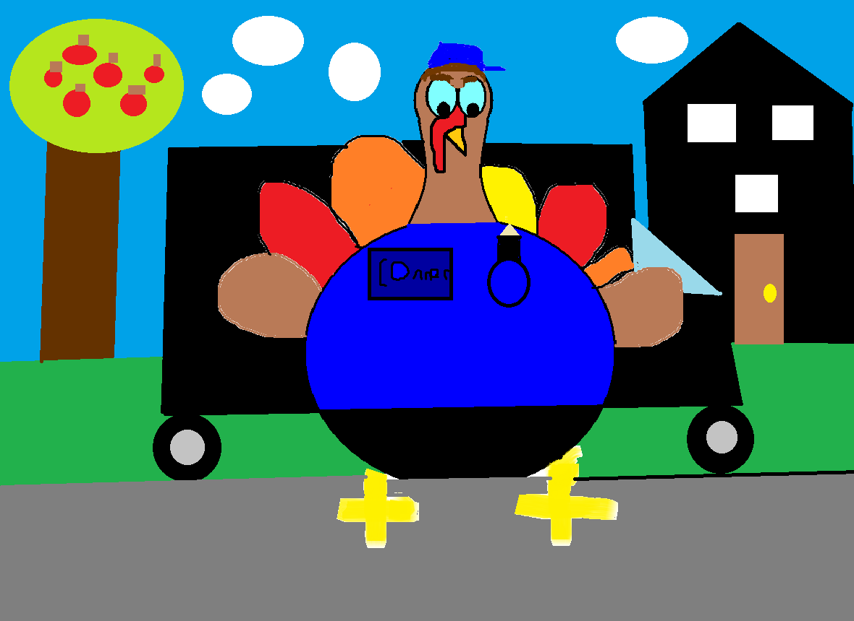
It would
be cool to be a
Mail man.

Slide 19
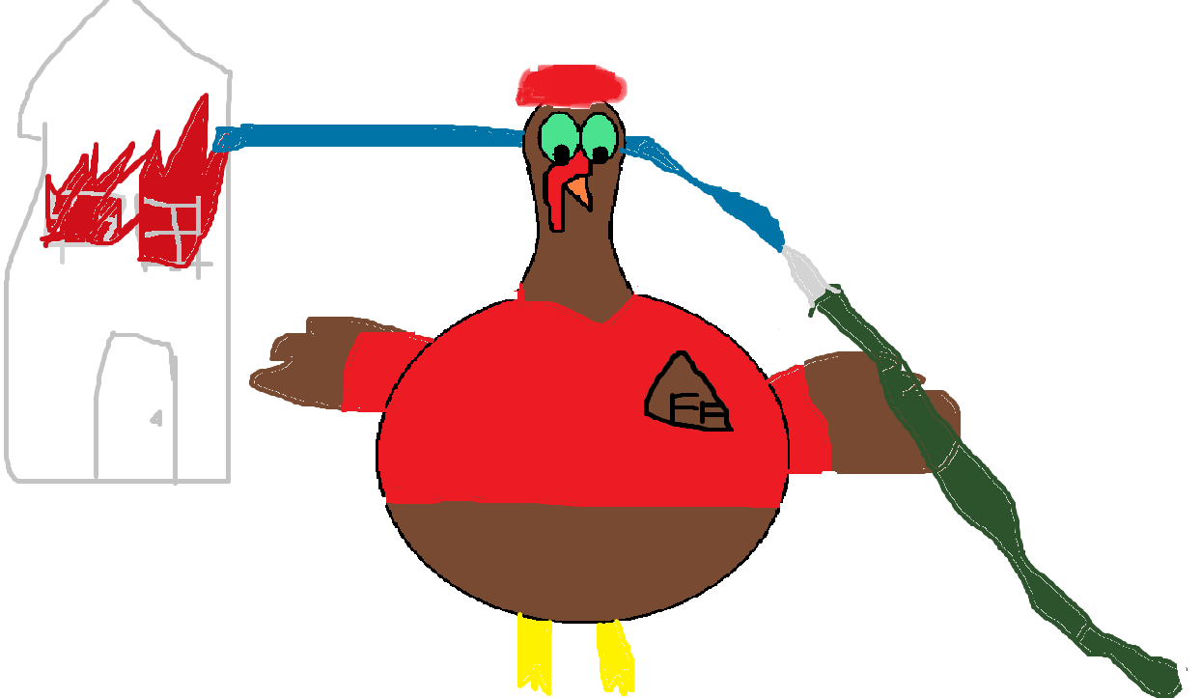
It would be helpful to be a firefighter because you can save people. You can spare things.

Slide 20
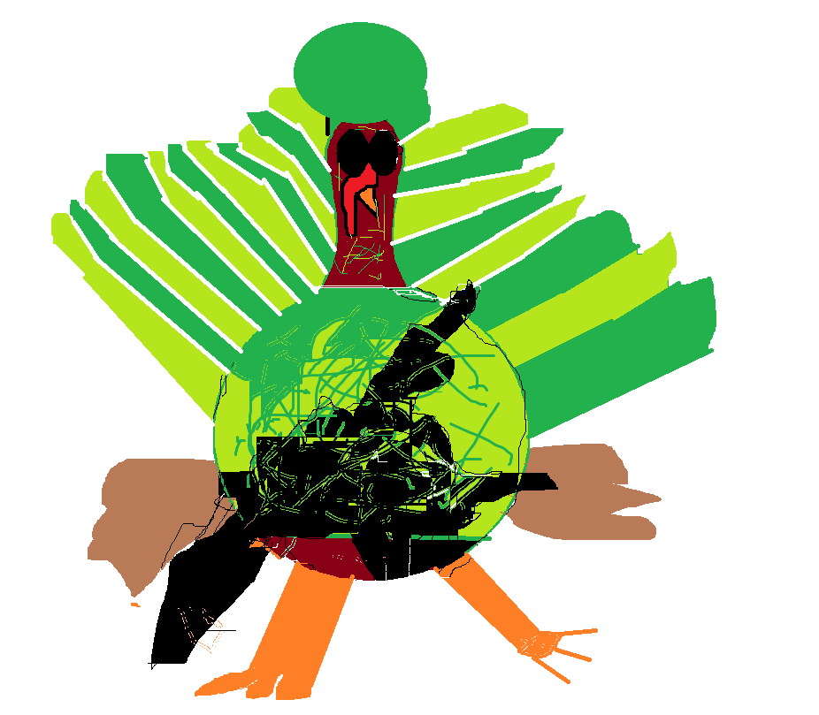
I think it would be helpful to be a marine…
I will help make this state
Will not be taken over
By other states.

Slide 21
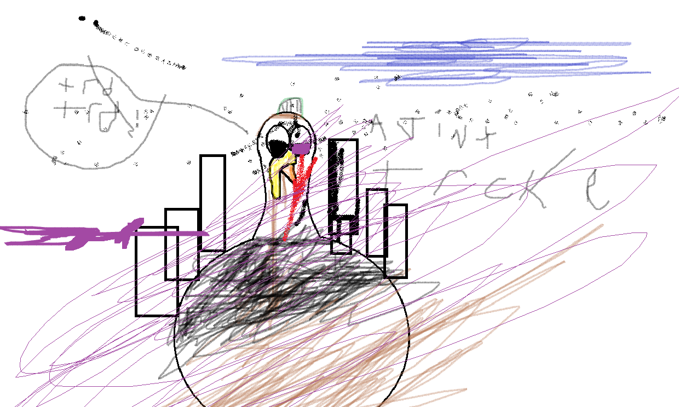
asam

