Slide 1
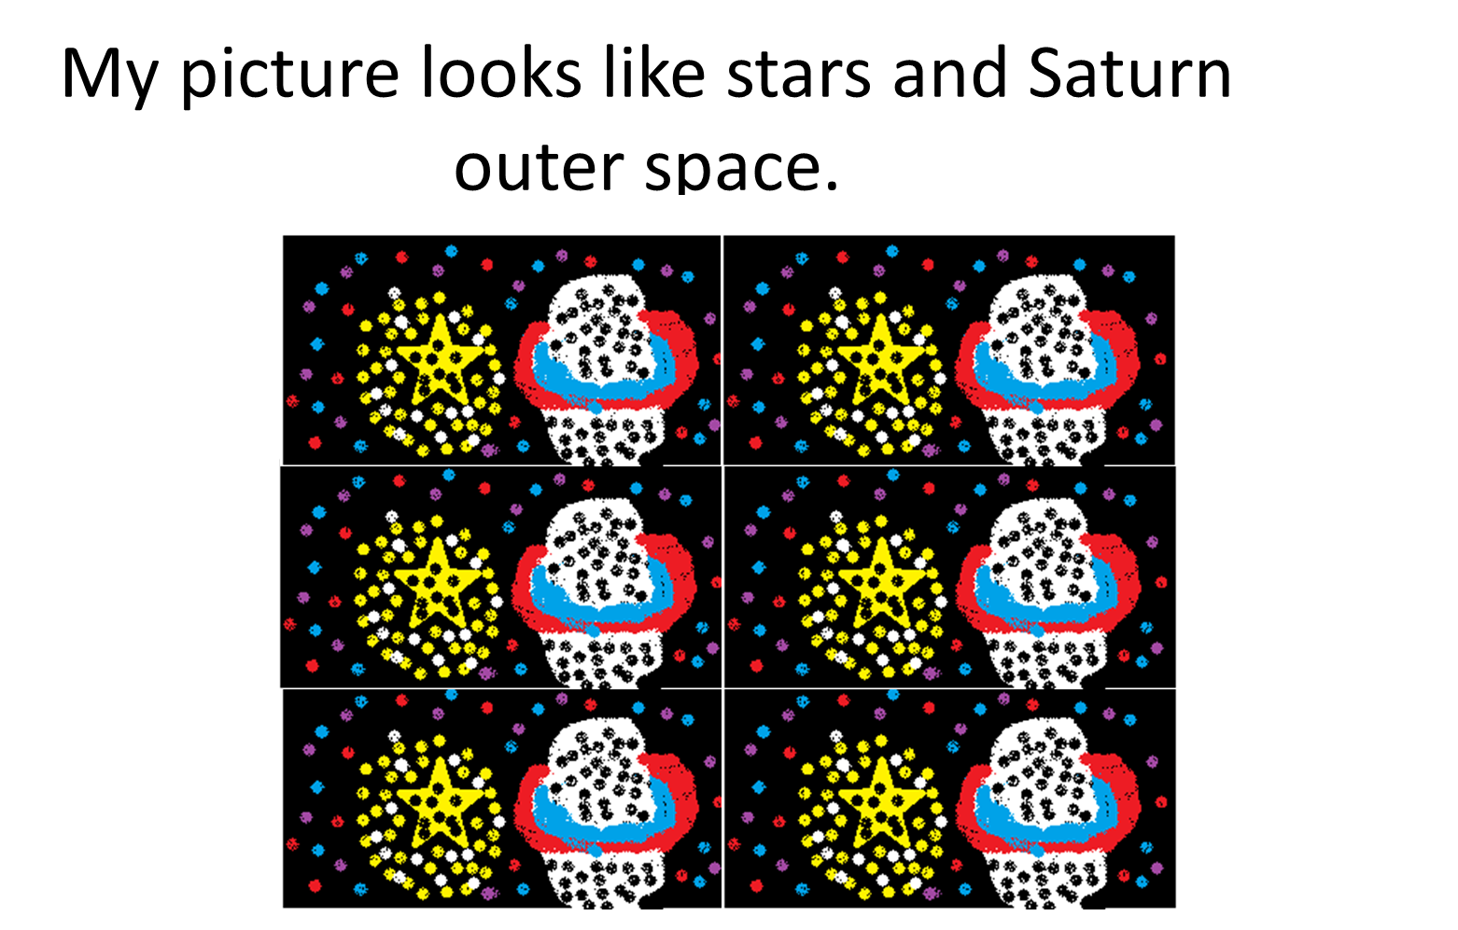

Slide 2
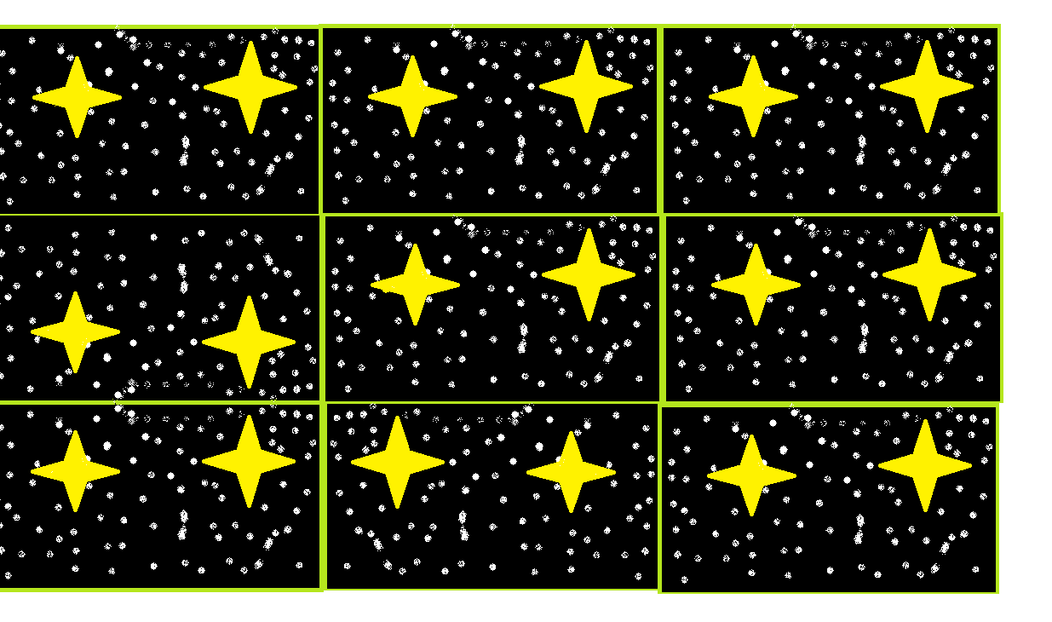
My picture is as cool as outer space laila peebles

Slide 3
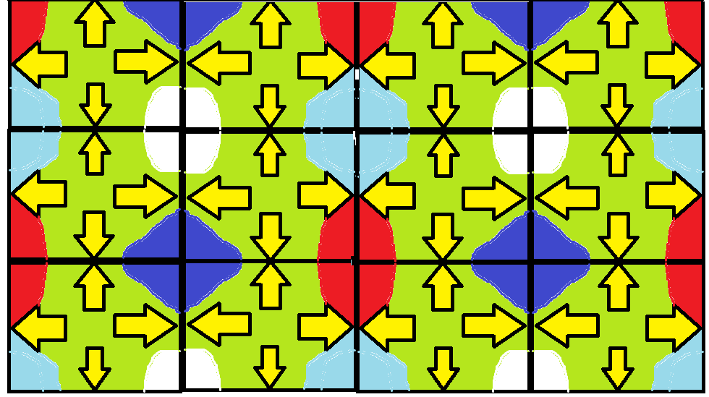
By:Eric melen
My design is as colorful as a mine full of ores!

Slide 4

My design looks like stars in the sky

Slide 5
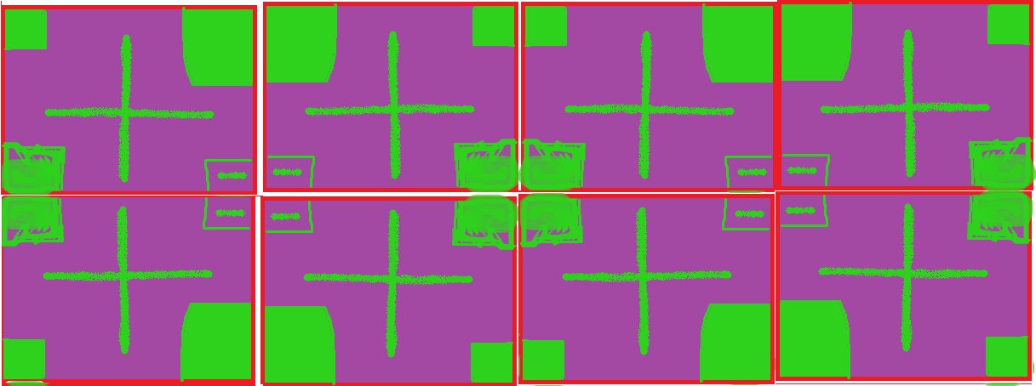
My Picture looks like a health pack.

Slide 6
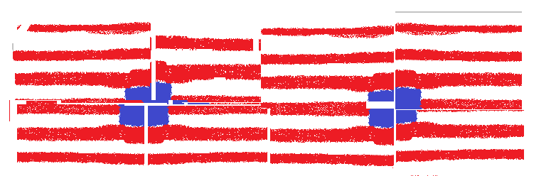
My picture looks like the American flag.

Slide 7
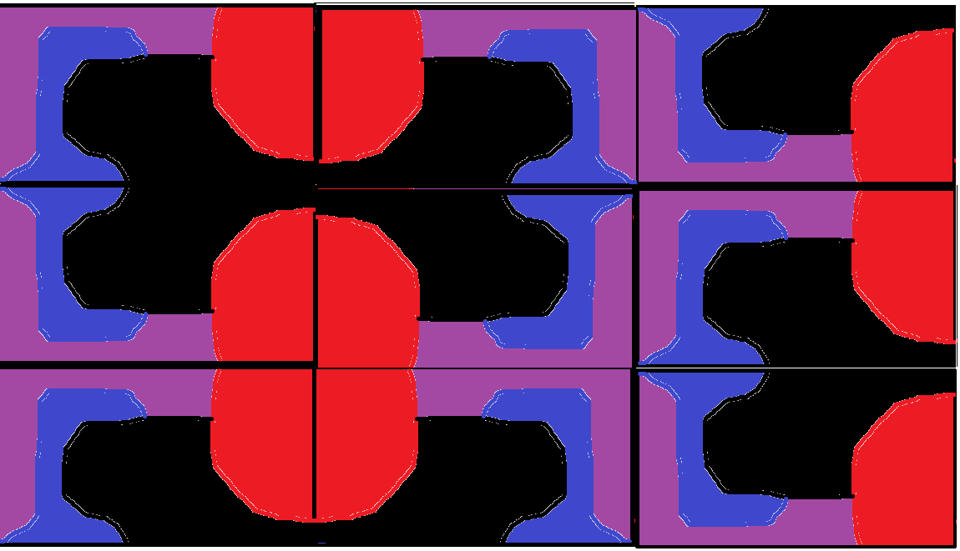
My Picture Looks Like bridges Water Coming Around.

Slide 8
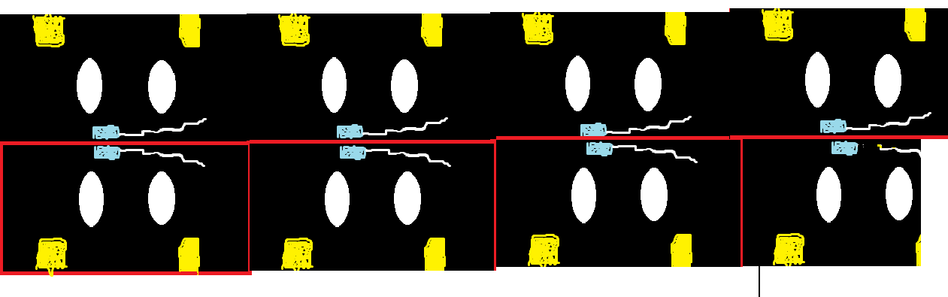
My design reminds me of bomb-om from Mario

Slide 9
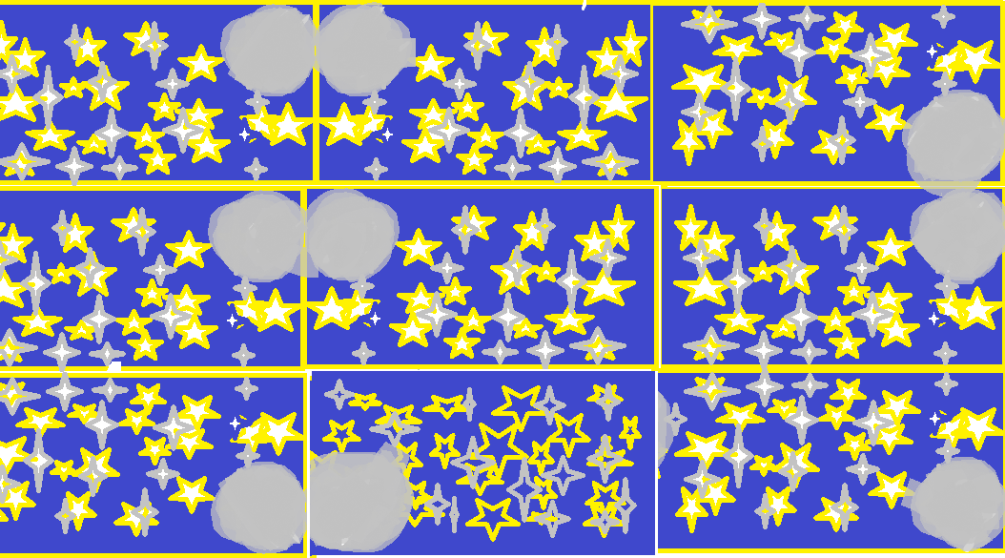
My design is like stars gazing in the moonlight.

Slide 10
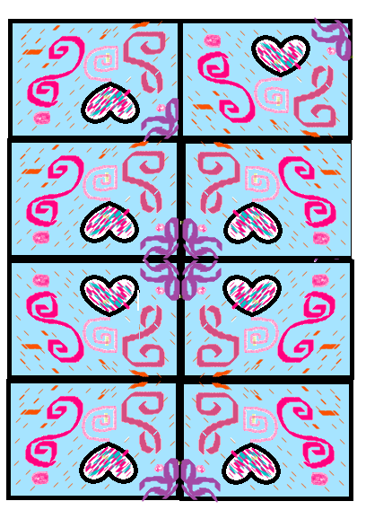
Mine looks like a sea with fish and shells on the sea floor.

Slide 11
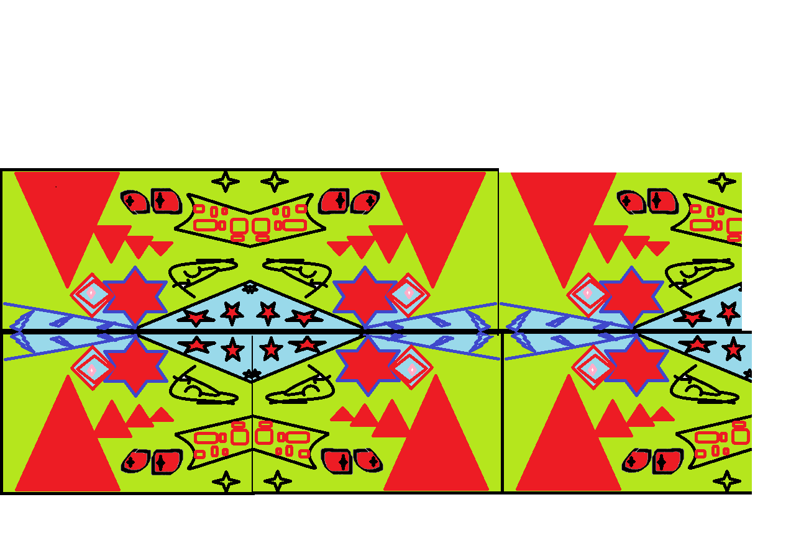
My picture look’s like a fair with big rollercoasters and stars and flags.

Slide 12
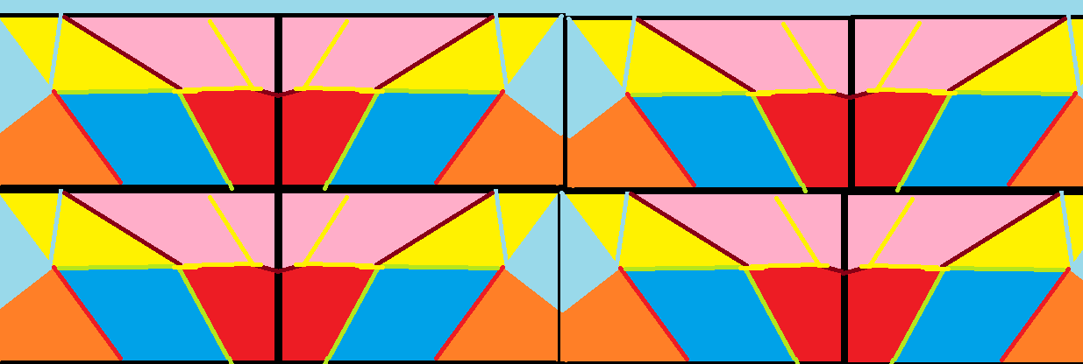
It looks like a mystery picture

Slide 13
My design looks like stars in the sky

Slide 14
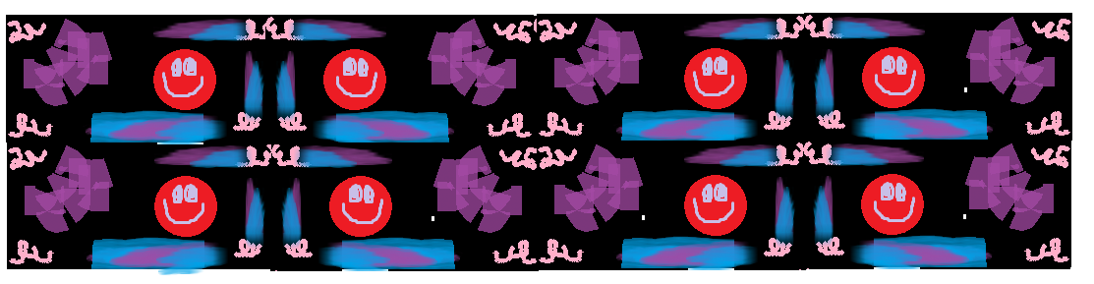
It looks like a crazy video game level☺

Slide 15
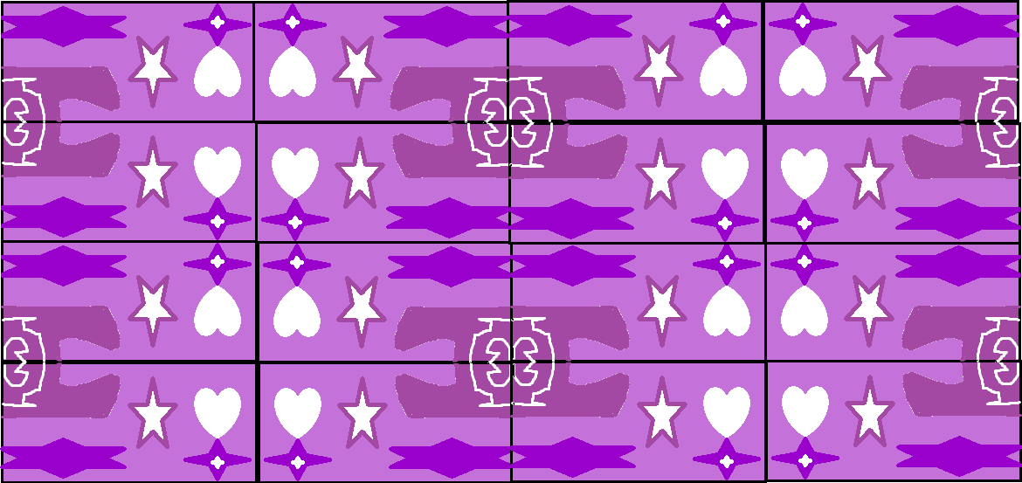
My design is like a valentines card.

Slide 16
My design is like the ocean floor.

Slide 17
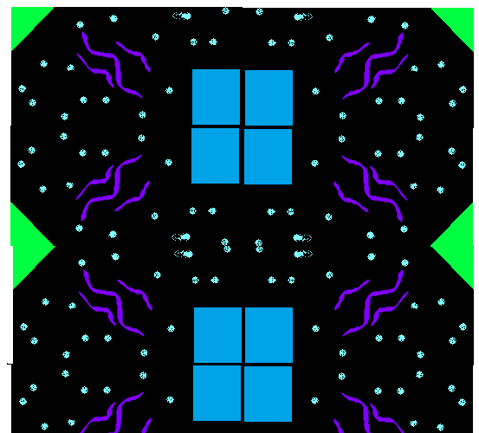
It looks like two satellites floating in space!

Slide 18
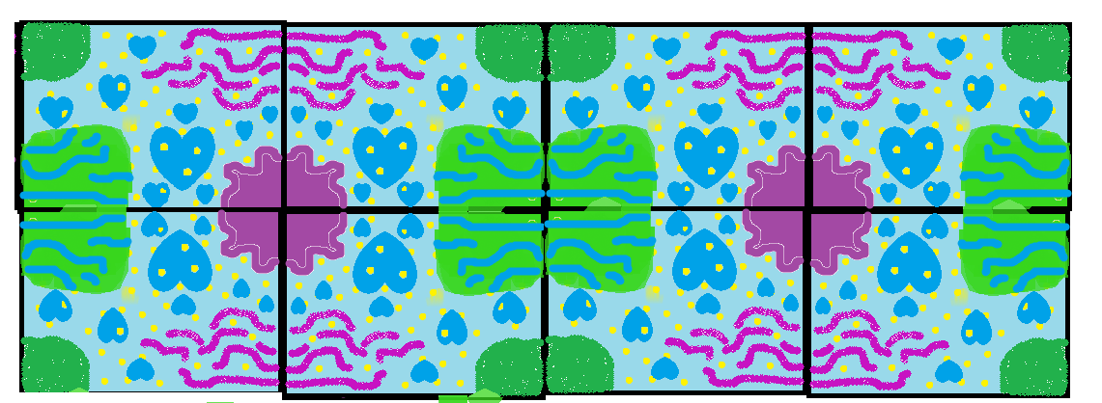
My design looks like coral under the sea

Slide 19
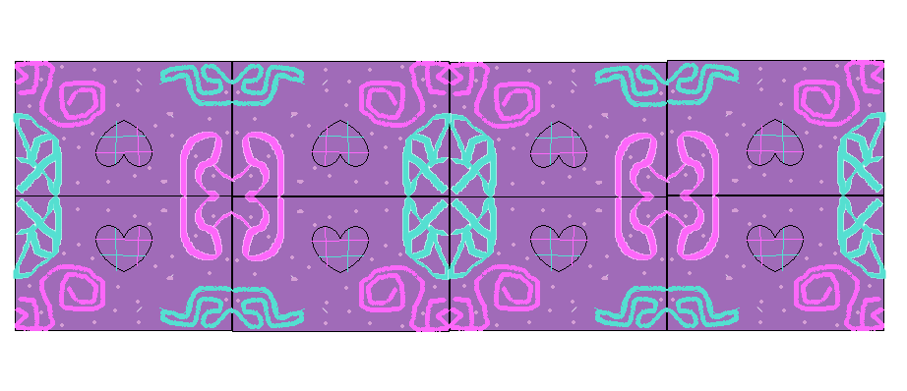
My design is as cool as a diamond in a cave.

Slide 20

My picture looks like mustaches with lighting.

Slide 21
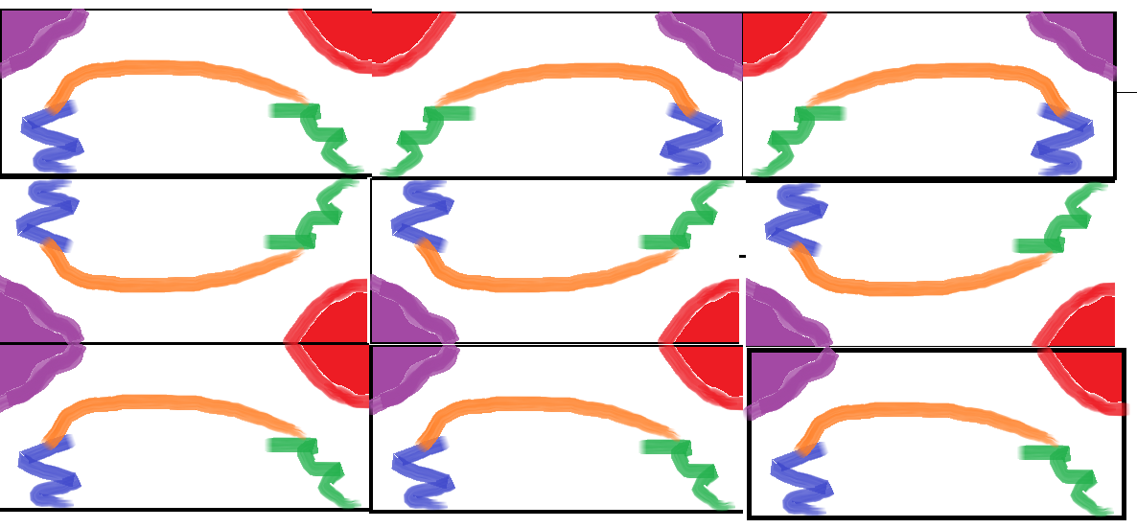
My painting is as colerful as a flamingo.

Slide 22
It looks like a tarantula getting shocked by electric cand

Slide 23
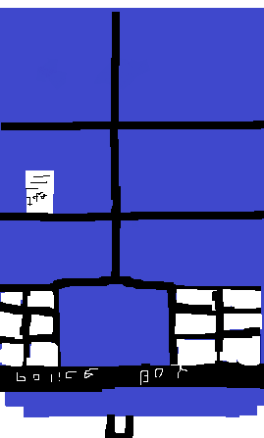
My design is the tardis

Slide 24
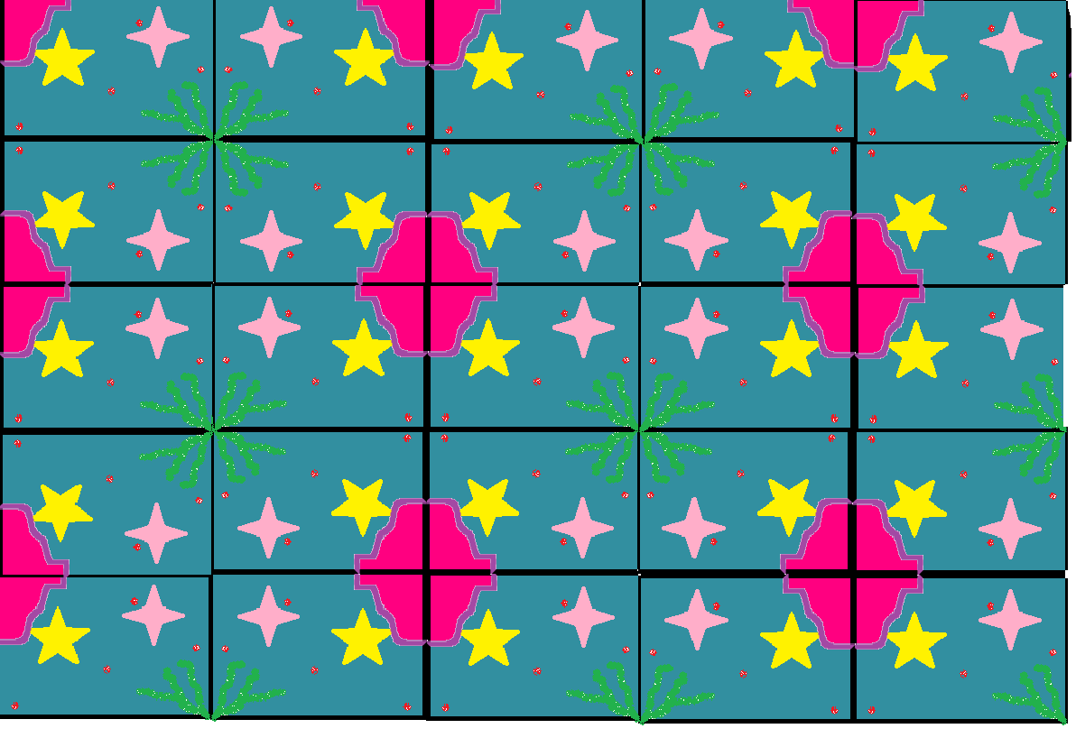
My design is like an under-water city with oysters ,see –weed , stars and red pearls that has been NEAVER discovered!!!

Slide 25
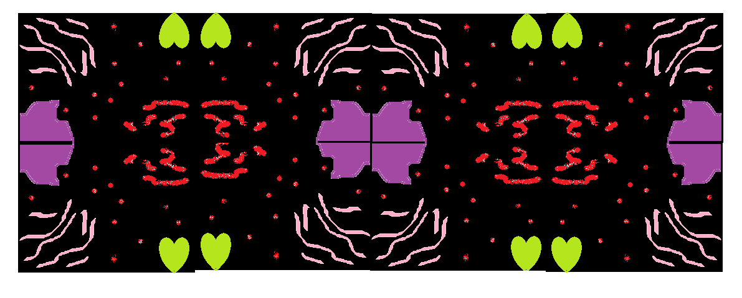
My design is like
falling into outerspace at
midnight.

Slide 26

My design looks like the half life symbol from a video game.

Slide 27
My picture looks like mustaches with lighting.

Slide 28
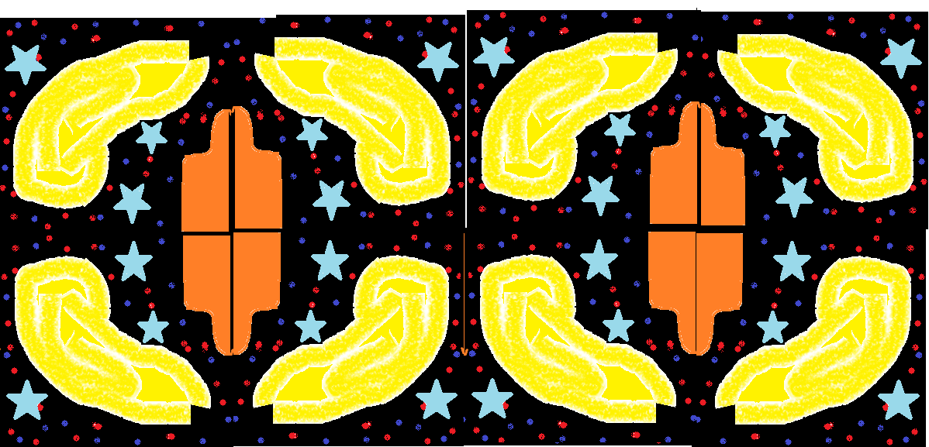
It’s crazier than a monkey playing the drums!!!!!!!!!!!!!!

Slide 29
My Pickcher looks like a pattern of blue and red

Slide 30
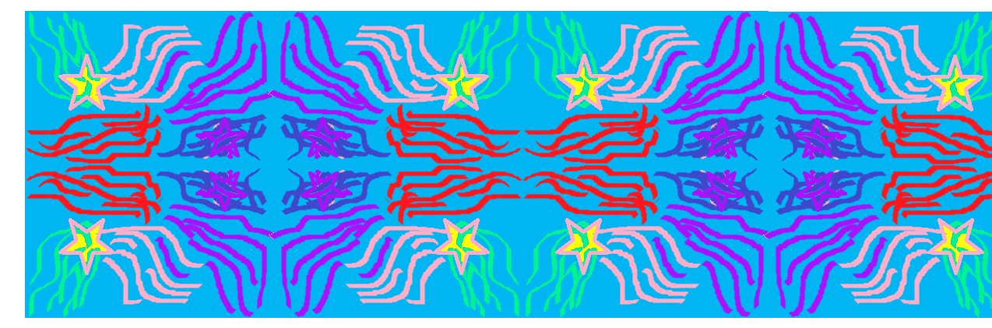
My design is like a maze with stars

Slide 31
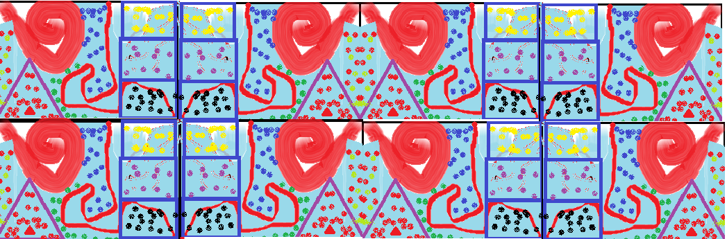
It looks like a colorful candy land

Slide 32
It’s like shooting stars!
And hearts!

Slide 33
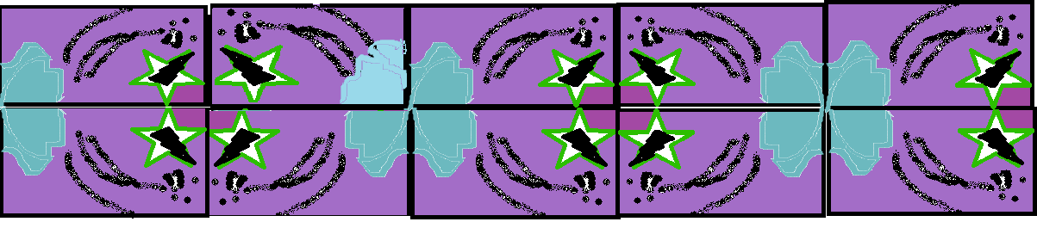
My design is a black panther in a jungle

Slide 34
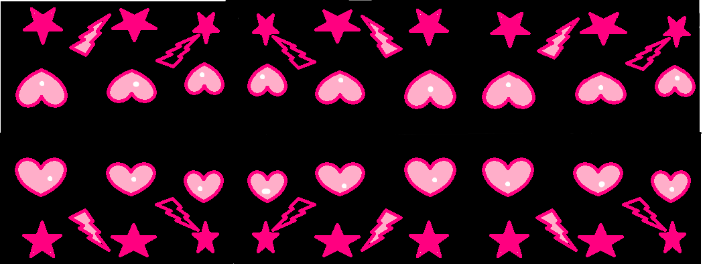
My design is like a rock star feelings after the show.

Slide 35
My design is a black panther in a jungle

Slide 36
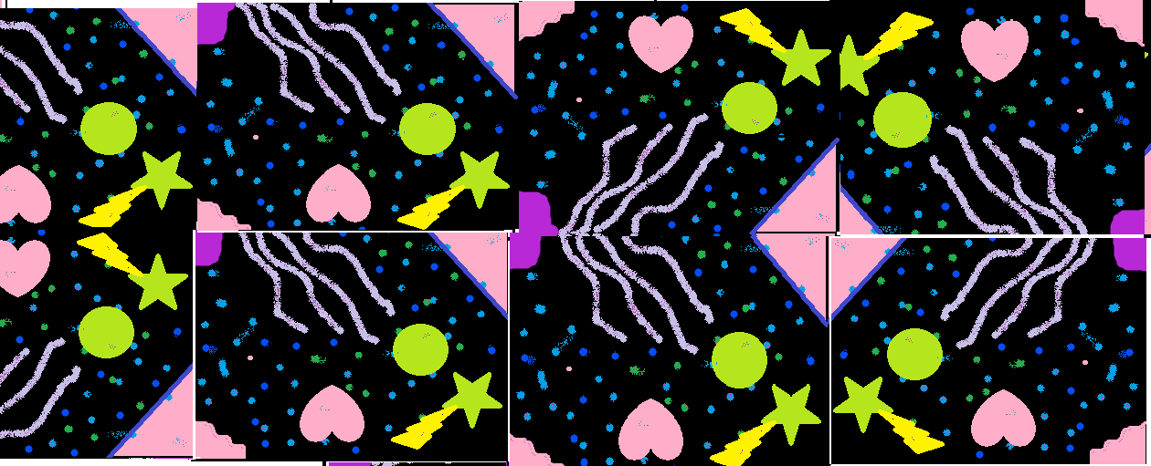
It looks like laser tag in the ocean!

Slide 37
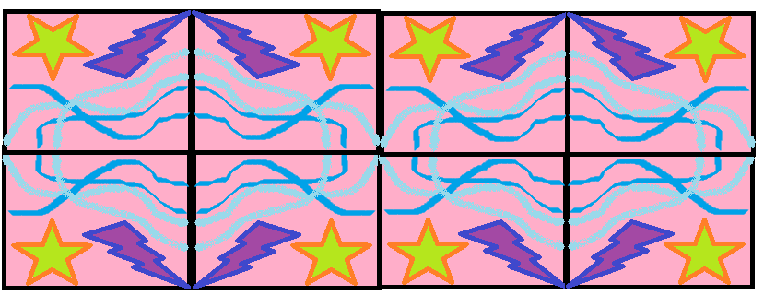
My design is like a water fountain in a thunder storm!

Slide 38
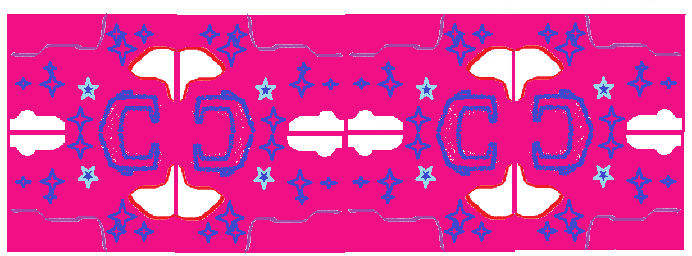
My picture looks like midnight with a pink sky.

Slide 39
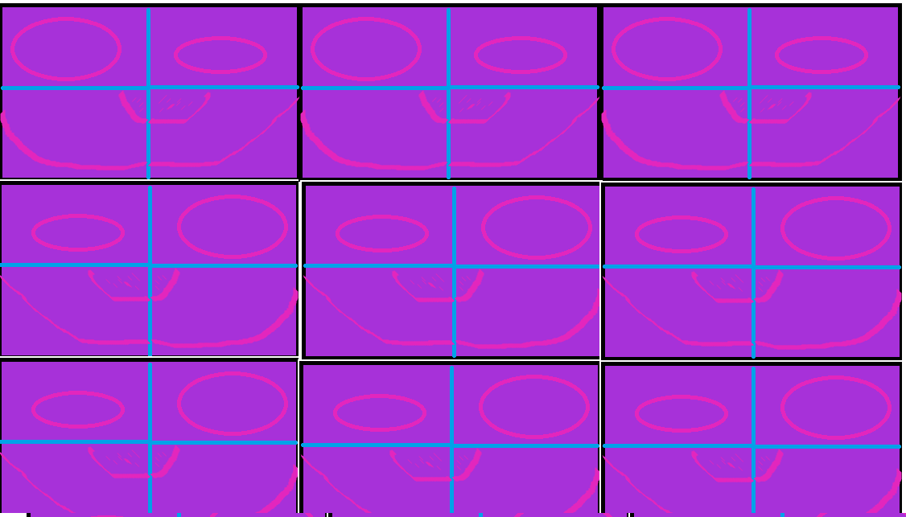
These look like dogs.

Slide 40
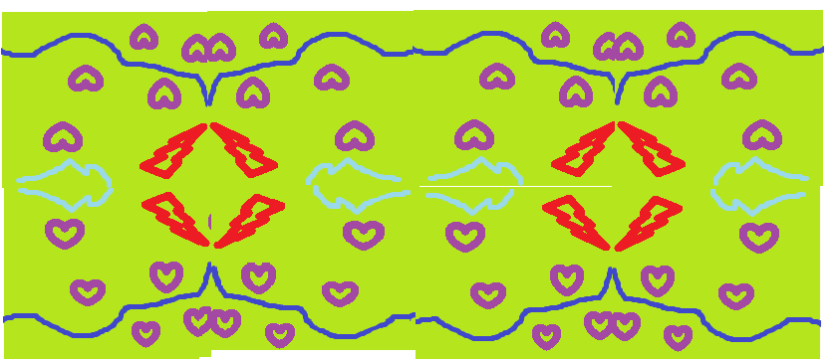
My picture is like Lighting heart

Slide 41
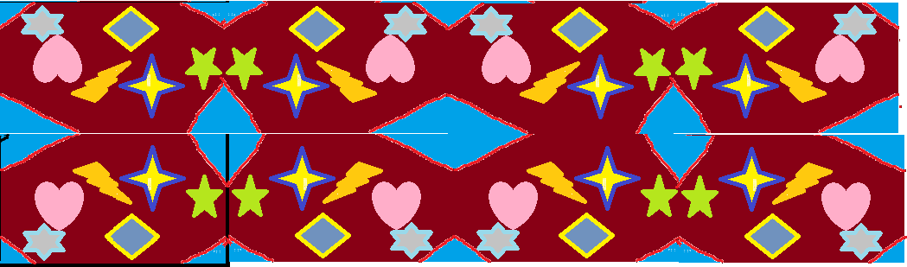
My picture looks like outer space at night

