Slide 1
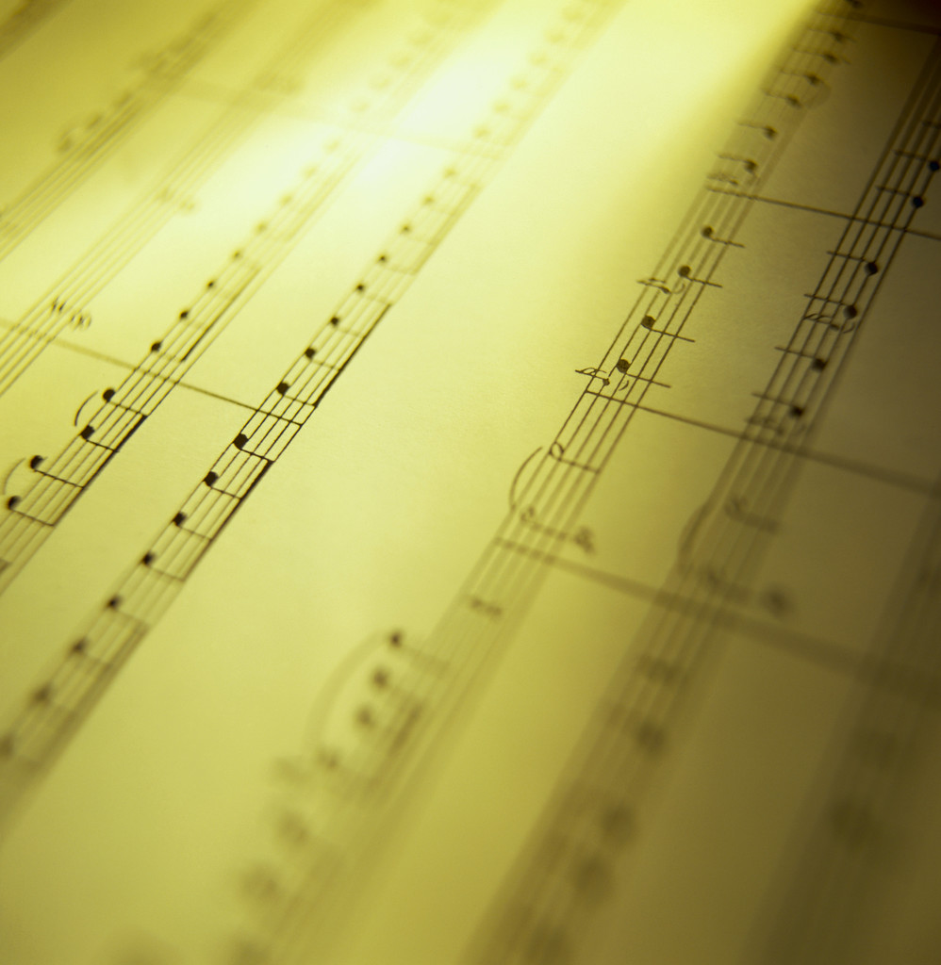
Fifth Graders Tell Us What They Think About Music

Slide 2
Mrs. Kimbrue’s Class

Slide 7
uty
Hgljggh\

Slide 13
Mr. Ryan’s Class

Slide 17
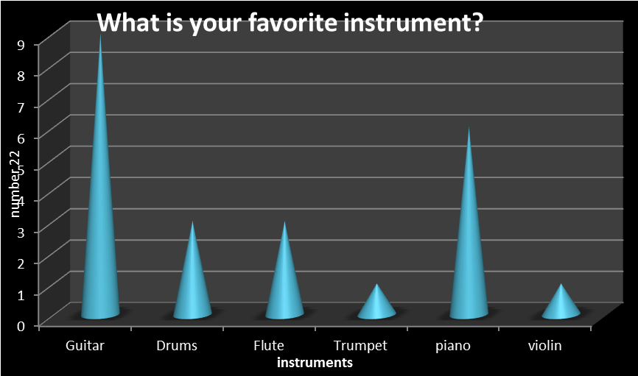

Slide 20
What is your favorite Disney song?
10
8
Number of
6
students
4
2
0
Do you
Mary
Let it go
Selena
want to
Poppins
Gomez
bulid a
snowman
Disney songs

