Slide 1
CREEK Expectations
4th graders know what is expected of them at Syring Elementary! By: 4th grade students

Slide 2

Commit to Learning
“ Follow the rules”

Slide 3

Include others in games.
Respect others

Slide 4


To be
Be to school on time.
Everyone is Responsible.

Slide 5


Report if there is anything suspicious.
Everyone is Safe

Slide 6

Kindness Counts
Sharing is caring and always follow directions.

Slide 7


Follow directions quickly.
Commit to Learning

Slide 8
Respecting Others
Respecting others is kind !!!

Slide 9
Turn in your work
be responsible
listen to others
Everyone is Responsible

Slide 10
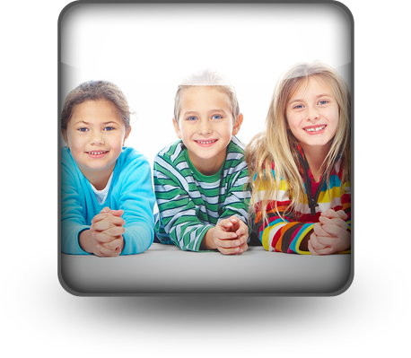

Invite others to play a game with you
Be safe!
Everyone is Safe

Slide 11
Treat others how you want to be treated.
Kindness Counts

Slide 12

Commit to Learning
Finish your work

Slide 13




Help everyone out.
Respect Others

Slide 14
Have your home work done everyday.
Turn in your work.
Everyone is Responsible

Slide 15
Don’t do stuff your not supposed to do.
Everyone is Safe

Slide 16
Kindness Counts
Be kind to others.

Slide 17
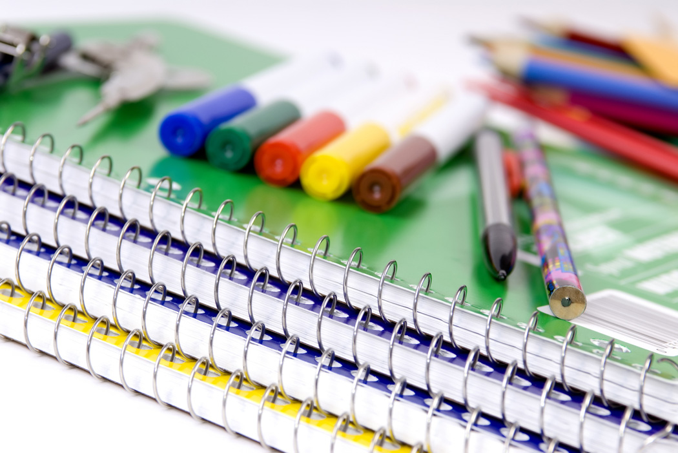
Be a good listener.
Complete all assignments.
Practice reading.
Commit to Learning

Slide 18
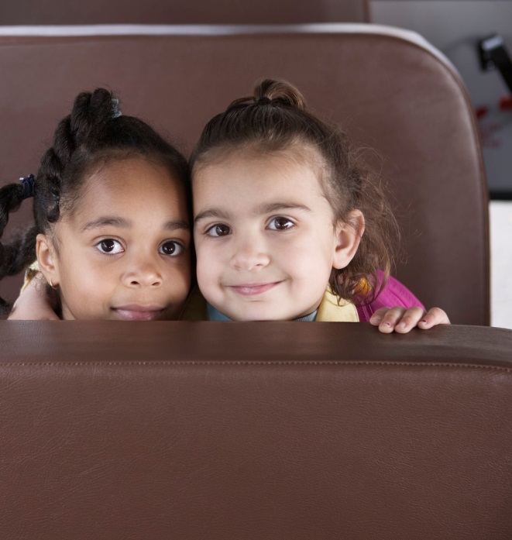

Keep your hands and feet to yourself.
Don’t say bad and mean things to people.
Don’t be bossy.
Respect Others

Slide 19

Everyone is responsible
Be responsible to others.

Slide 20

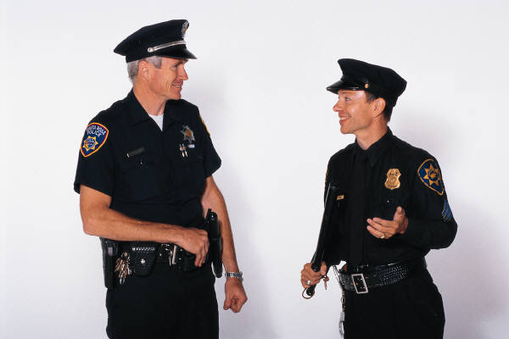
Everyone is Safe
Follow rules in school.
Follow all laws.

Slide 21
Kindness Counts
You should always help people in need.

Slide 22
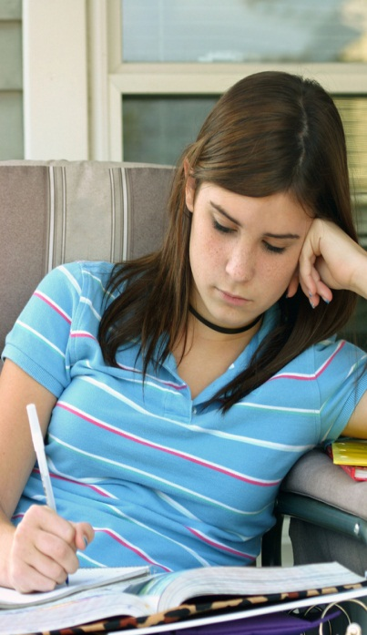
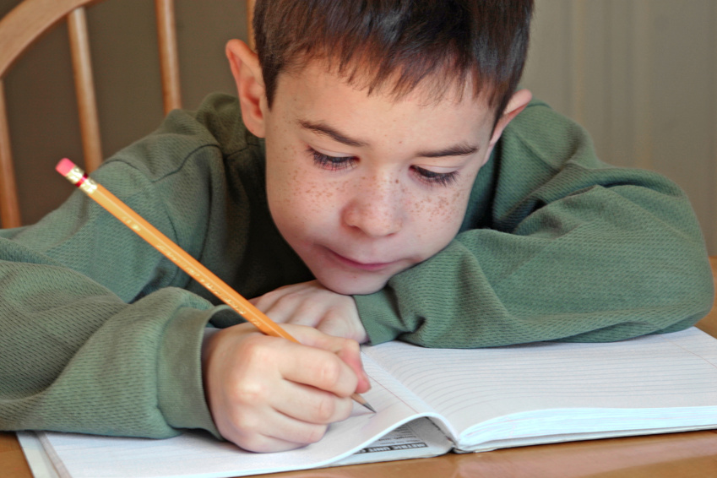
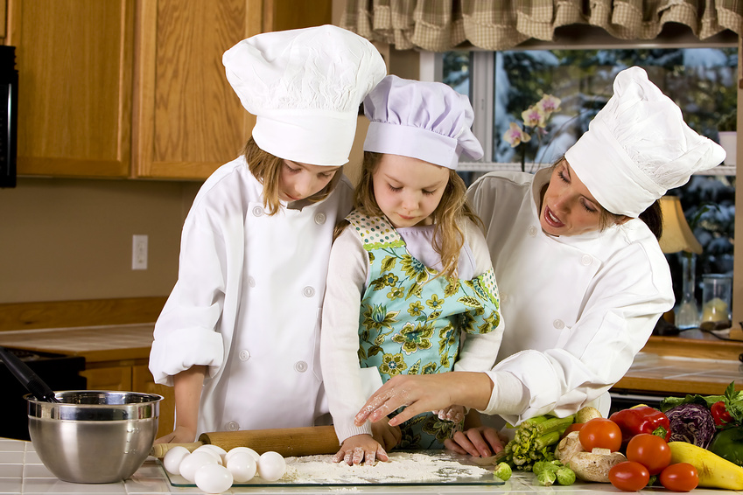
Committing to learning is doing homework and listening!
Commit to Learning!

Slide 23

You need to treat people how you want to be treated, that’s respecting others.
Respect Others

Slide 24
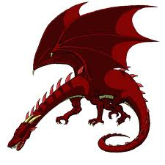

To be responsible at school you must turn your work in on time and you must come to school on time
Everyone is Responsible

Slide 25
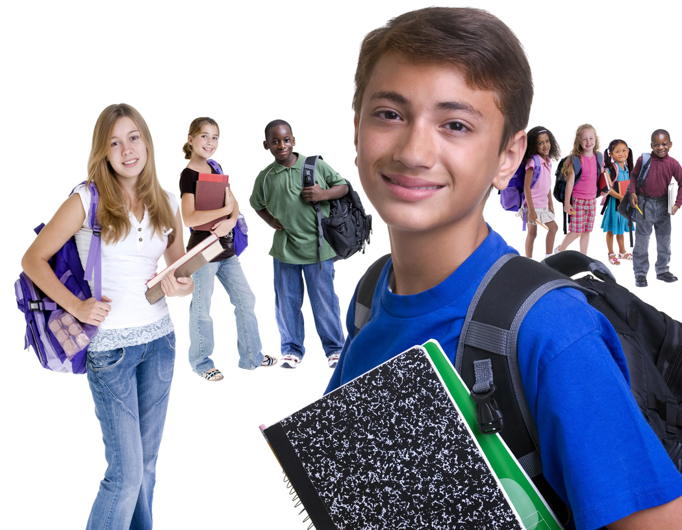
Everyone is Safe
Hands by your side in the hallway.
Be kind to others and yourself.
Stay seated on the bus.
Stay safe on the playground.

Slide 26
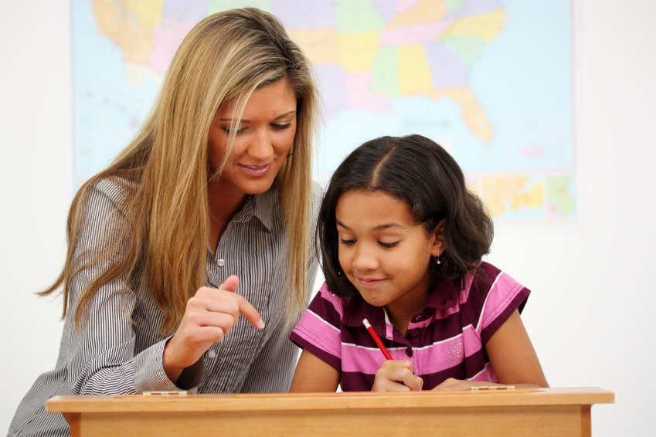
Kindness Counts
Share with others.
Respect the teacher.

Slide 27
Commit to learning
      Be good others. Do all your work. Be kind.

Slide 28
Help each other
Listen to an adult
Follow all rules
Respect Others

Slide 29



Clean up after recess and lunch!
Everyone is Responsible

Slide 30

You stay seated, don’t hit, kick, and pinch.
Everyone is safe

Slide 31
Be kind to your friend.
Kindness Counts

Slide 32


Commit to Learning
Listen to your teacher.
Bring your homework every day.
Come to school prepared.
Follow the creek rules.

Slide 33
Help others
Don’t be a bully
Play together with out arguing
Listen to a teacher
Respect Others

Slide 34

Do the right thing.
Everyone is Responsible

Slide 35
Everyone is safe
Follow directions and you will be safe

Slide 36
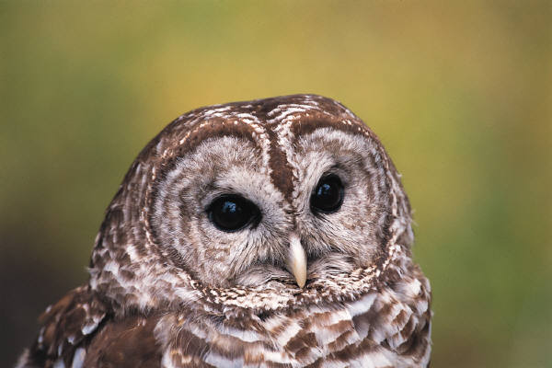
Kindness COUNTS
Be kind to others

Slide 37


Commit to Learning
Listen to your teacher the first time.

Slide 38
Respect Others
Be polite and use good manners.

Slide 39

Don’t be a by stander or the dragons going to get you!!!
Everyone is Responsible

Slide 40
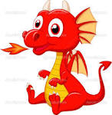

Protect yourself and others !!!!!!!
Everyone is safe!!!.

Slide 41


Include everyone
Help others
Kindess Counts

